Slide 1

“CONFIDENTIAL – FOR NeGDv(MeitY) USE ONLY”
Jio Consent Management System
Functional Overview
This document is submitted only for Code for Consent Challenge, organized by NeGD (a part of MeitY) and shall not be used for any other purpose.

Slide 2
Key Differentiator of Jio Consent Management System
1) It allows Data fiduciaries to download Certificate 65B to prove the consent immutability in court of law.
65 B can be downloaded for consent immutability.
2) Empanelled Agency VAPT Certified - Certificate in GitHub repository.
3) Granular Consent Customisation
Enable users to give purpose-specific, time-bound, and revocable consent per data type with intuitive dashboards that translate legal jargon into human-friendly language.
4) Cryptographically Verifiable Consent Artefact and Immutable Audit Trail
Generates cryptographically verifiable consent artefacts (Digitally Signed by the Data fiduciary and certificates (Keys) generated in the Jio Consent Management System vault. Generates with timestamped immutable logs, ensuring compliance audit readiness.
5) Offline Consent Collection at Point of Sale (POS) where Personal Data Is Required
It empowers businesses to securely collect consent from walk-in customers when personal data is needed. The system generates a time-bound consent request that can be shared via SMS, WhatsApp, Email, or displayed as a QR code at the counter. Customers can scan or open the link on their device to review and approve, ensuring compliance, convenience, and a frictionless in-store experience.

Slide 3
Functional Overview
Consent Management Lifecycle
Cookie Consent Management Lifecycle
Grievance & Rights Management
Notification & Communication Services
Audit & Compliance
CMS Portal & Admin Console
Identity, Access & RBAC
Integration Framework
Cross-Cutting Platform Services

Slide 4
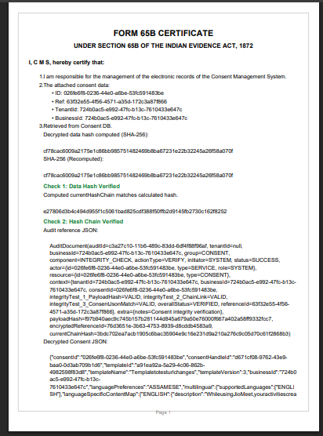
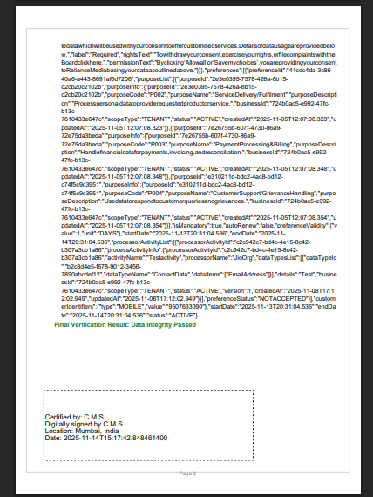

Slide 5
VA PT report

Slide 6
Consent Management Lifecycle
Consent Creation (Grant) Allows Data Principals to provide consent through an embedded, secure UI. Captures purpose, data categories, processors, and validity with a digitally signed consent artifact.
Consent Update / Modification Enables Data Fiduciaries to update purpose, processors, or processing activities. Automatically triggers a re-consent workflow ensuring the Data Principal reviews and accepts updated terms
Consent Withdrawal Allows users to withdraw consent at any time through dashboard or via DF-linked UI. Withdrawal is logged immutably and triggers DF/processor callbacks for data stoppage.
Consent Renewal Automatically notifies Data Principals when consent is approaching expiration. Provides a streamlined re-approval flow with versioned artifacts.
Consent Audit Trail Each consent action generates an append-only immutable record containing hashes, timestamps, actor identity, and cryptographic signatures for regulatory compliance.
Consent Verification API Any DF or processor can verify the authenticity of a signed consent artifact using public keys. Ensures non-repudiation and tamper-proof validation
Versioned Consent Records CMS maintains a sequential chain of consent versions without changing the Consent ID. Ensures historical traceability for compliance and disputes.
Minor/Parental Consent Supports parental consent collection for minors. A secure link is sent to the parent who completes KYC (e.g., DigiLocker) before granting consent.

Slide 7
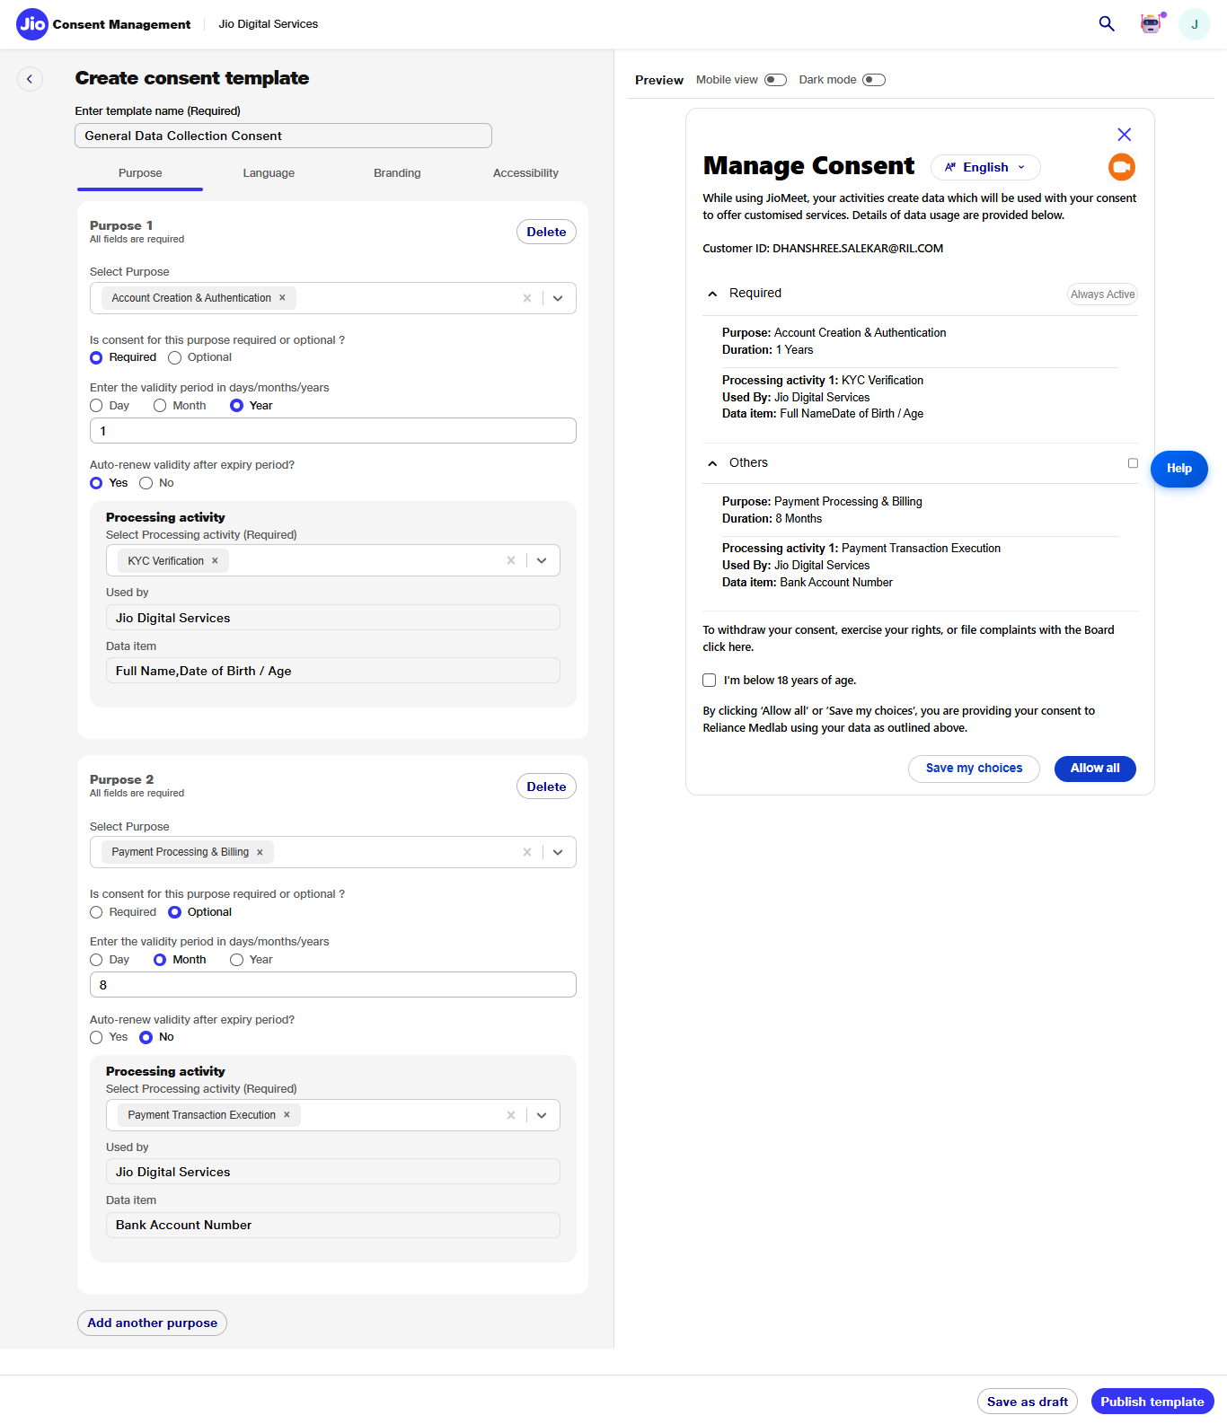

Slide 8
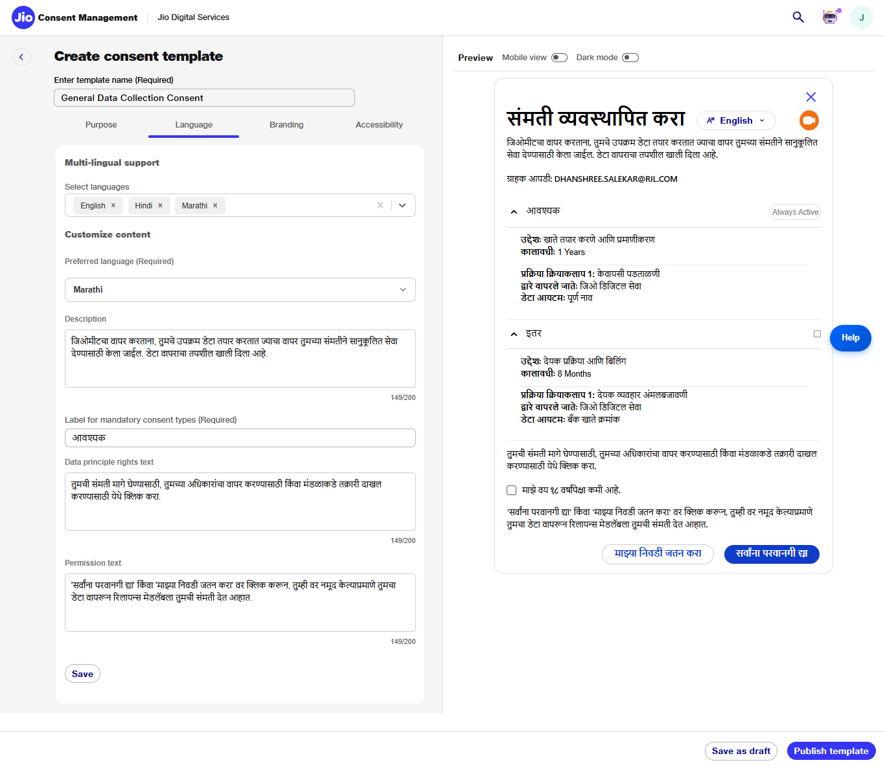

Slide 9
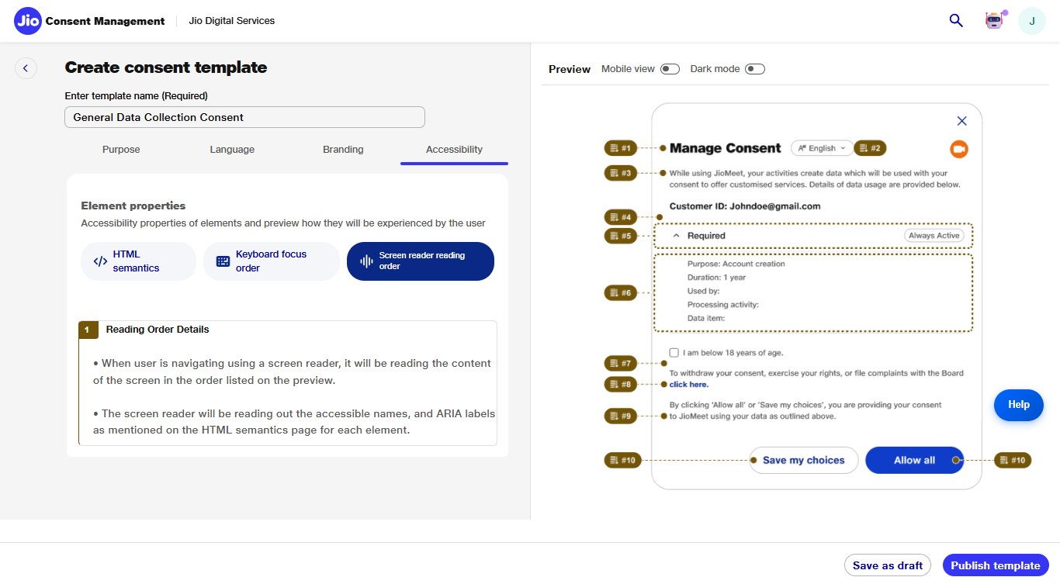

Slide 10
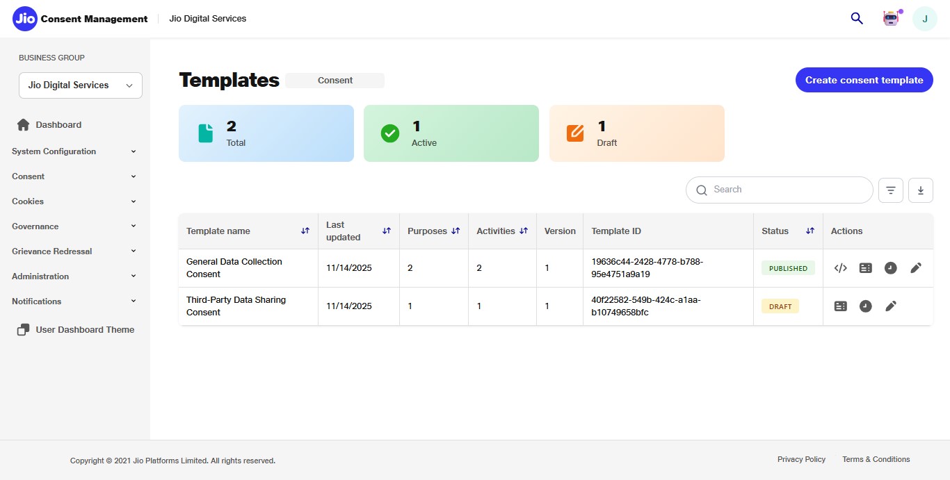

Slide 11
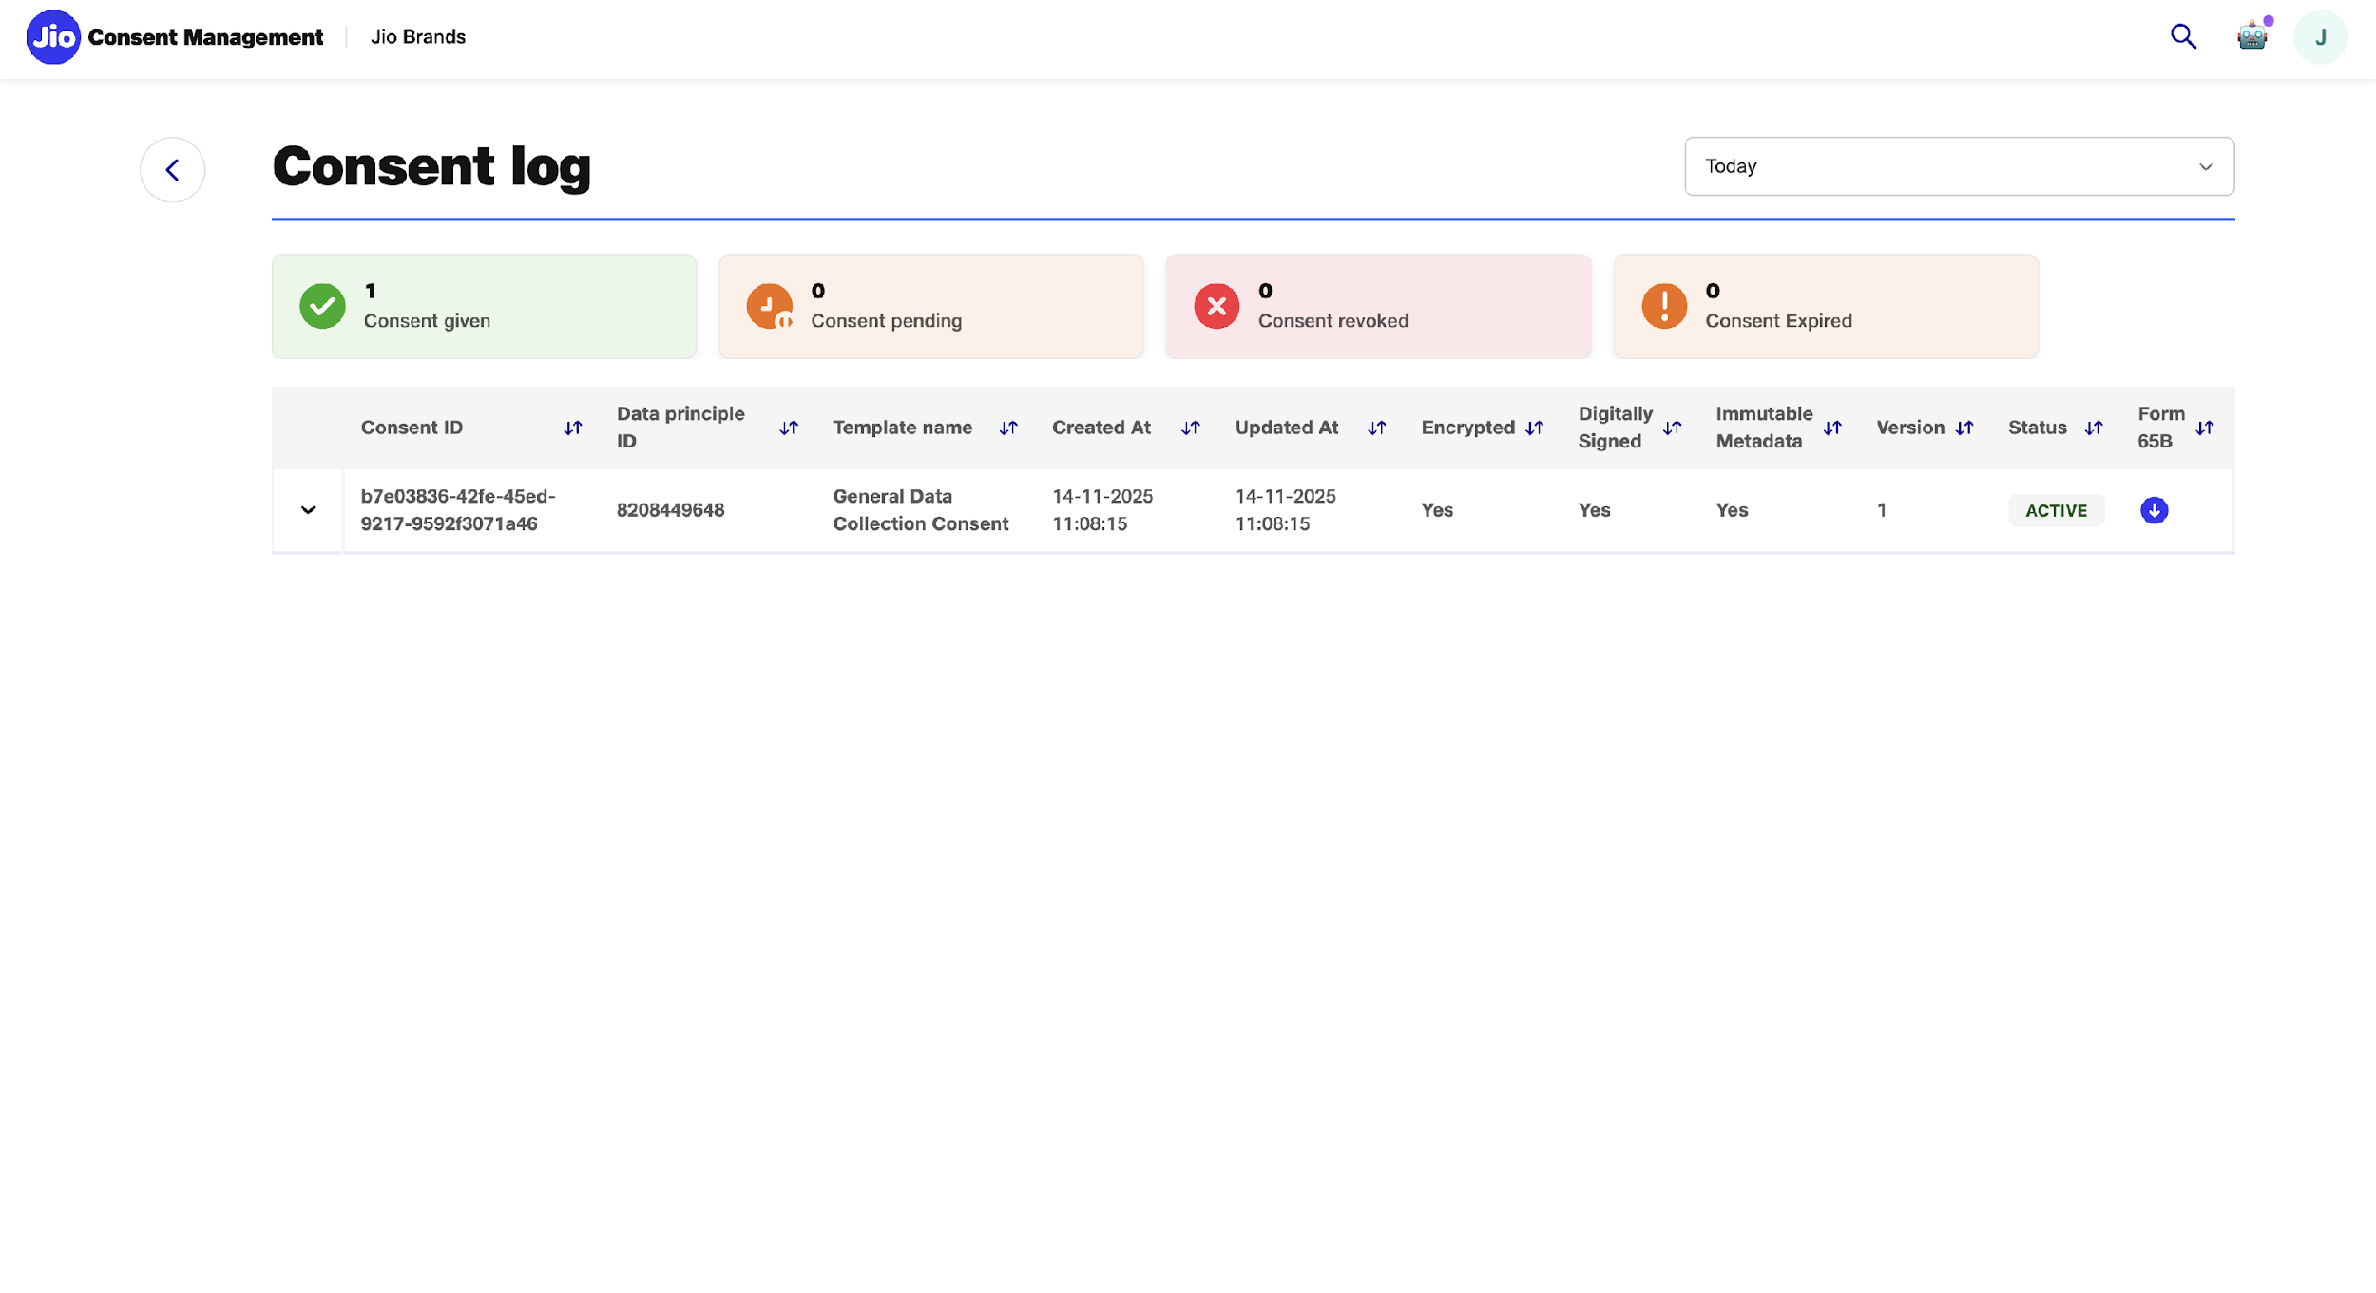

Slide 12
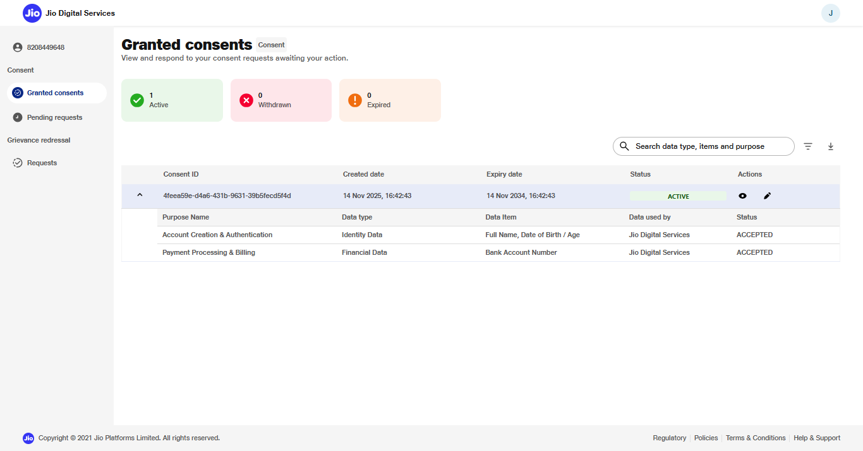

Slide 13
Cookie Consent Management Lifecycle
Cookie Banner (Embedded)
Displays DF-branded cookie banner to collect user preference for categories like Functional, Analytics, Marketing, etc., complying with global privacy laws.
Cookie Preference Storage
Records user preferences along with category-level timestamps and device metadata in an immutable log, supporting audits and compliance review.
Cookie Preference Update/Withdraw
Allows users to revisit and modify cookie settings anytime. Updates are logged and may trigger DF-side changes to tracking scripts.
Multi-language Cookie UI
Provides cookie screens in 22 Indian languages using the Translation Service, ensuring inclusivity and regulatory alignment.

Slide 14
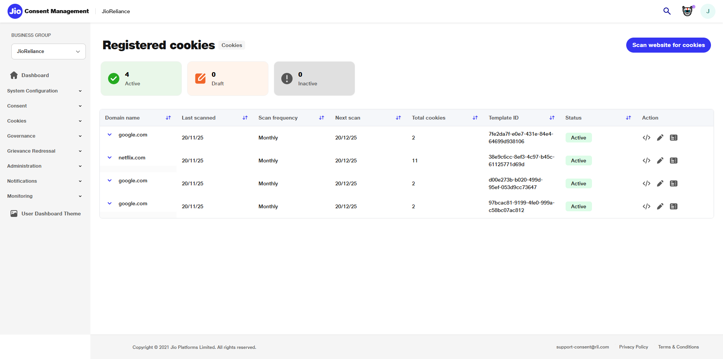
Notes:
Voiceover
"This is the Registered Cookies dashboard where business users can track scanned websites, their cookie counts, scan frequencies, and current template statuses."
On-Screen Text
Title: Registered Cookies Subtitle: Overview of Scanned Sites Key On-Screen Text: Active • Draft • Inactive • Configurable Scan Frequency
CTA: Start Cookie Scan
Highlight Elements: Highlight ‘Scan website for cookies’ button

Slide 15
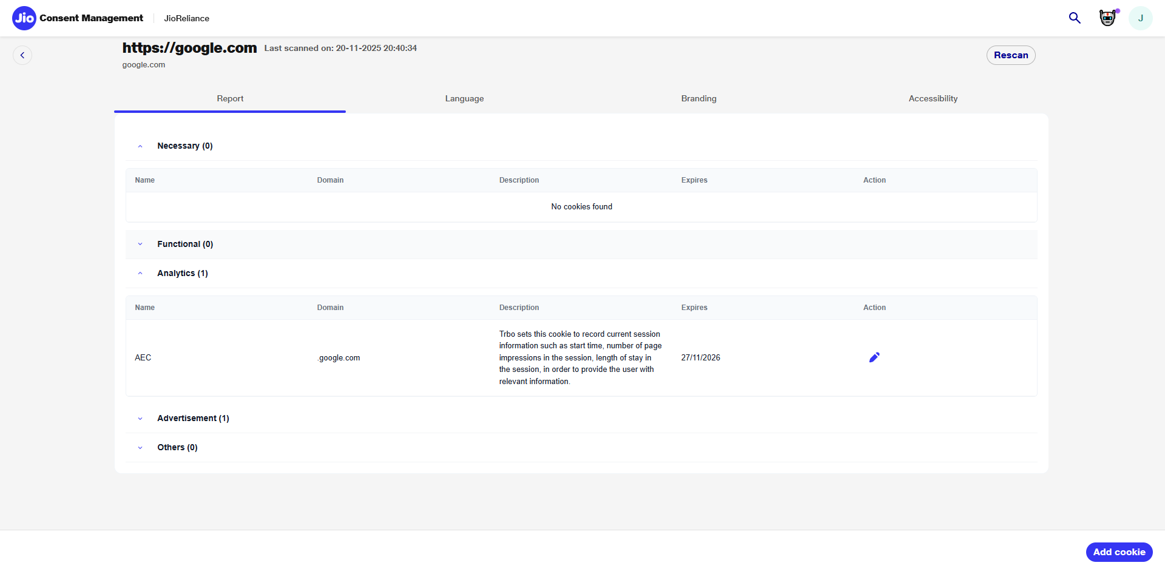
Notes:
Voiceover
"The updated cookie immediately reflects in the scan report, ensuring accuracy and compliance with disclosure requirements."
On-Screen Text
Title: Cookie Updated Subtitle: Reflected in Scan Report Key On-Screen Text: Real-Time Update • Accurate Metadata
CTA: Add New Cookie
Highlight Elements: Updated cookie row

Slide 16
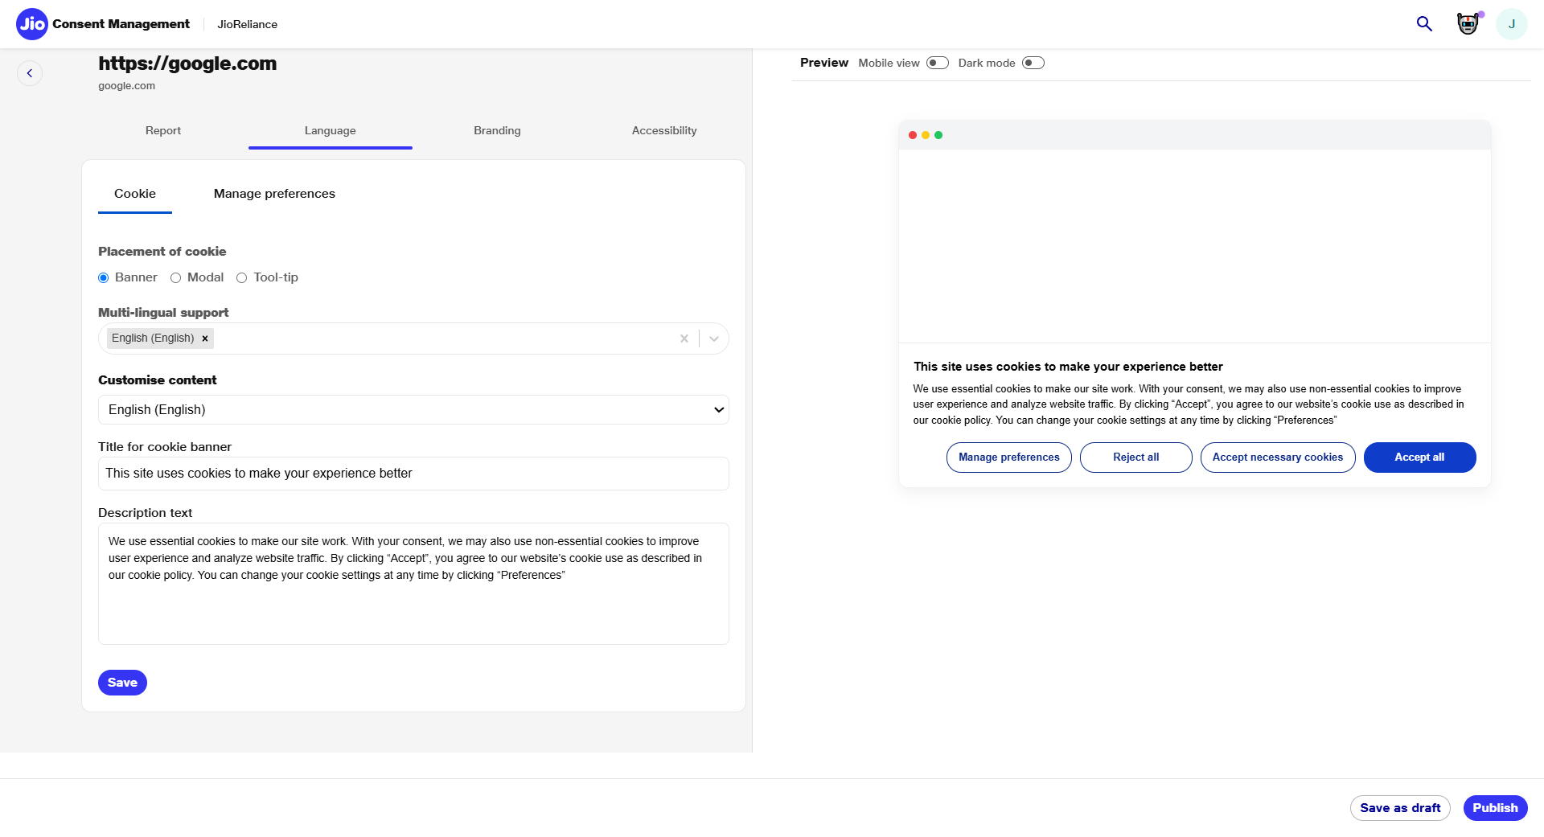
Notes:
Voiceover
"Business users can configure the cookie banner language, placement, and preview how the banner will render across devices."
On-Screen Text
Title: Language Settings Subtitle: Banner Customization Key On-Screen Text: Multi-Lingual Support • Custom Messages
CTA: Manage Preferences Screen
Highlight Elements: Language dropdown → Banner preview

Slide 17
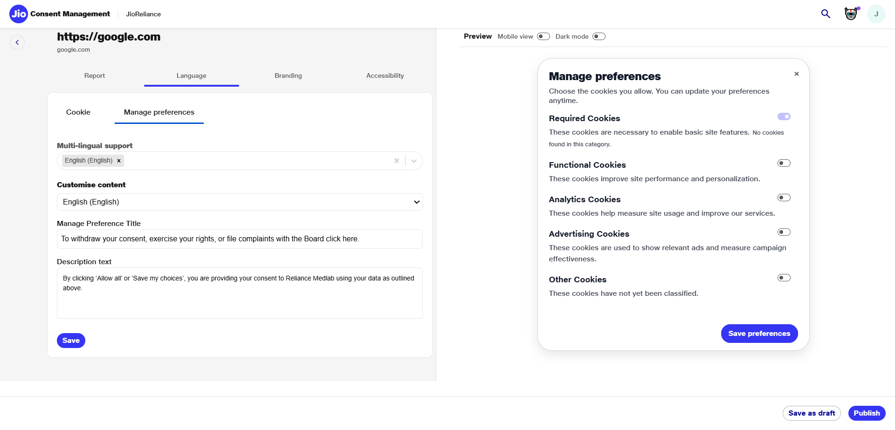
Notes:
Voiceover
"Each preference section can be customized, including titles, descriptions, and multilingual content to meet regulatory clarity requirements."
On-Screen Text
Title: Manage Preferences Subtitle: User-Facing Text Configuration Key On-Screen Text: Required • Functional • Analytics • Advertising
CTA: Continue to Branding
Highlight Elements: Manage preferences tab

Slide 18
Grievance & Rights Management
Raise Grievance / Rights Request
Enables Data Principals to raise issues (access, correction, erasure, dispute). Form-driven UI ensures completeness with mandatory metadata.
Grievance Lifecycle Management
Tracks every grievance from submission to resolution with timestamps, DF updates, DPO escalations, and SLA monitoring.
Grievance Artifact Signing
Each grievance submission generates a signed, immutable artifact for audit and legal verification. Protects both DF and Data Principal.
DF & DPO Workflow Integration
CMS allows DF admins to update status as In-Progress, Resolved, or Escalated. Automated SLA-based reminders and DPO escalation workflows ensure timely closure.

Slide 19
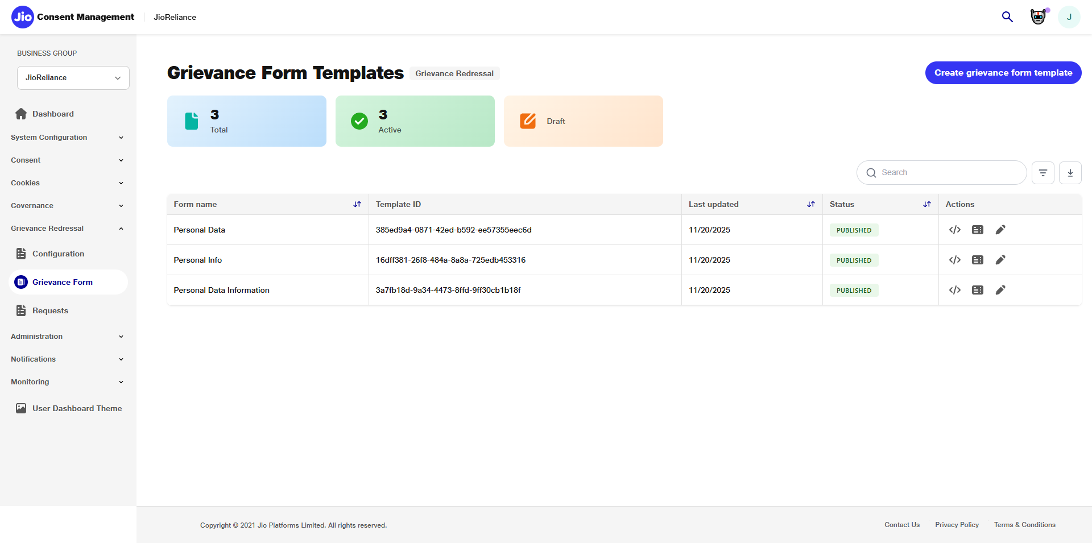
Notes:
Voiceover (~10 sec) “Next, the business user opens the Grievance Form Templates page, which lists all existing templates and allows creation of new standardized forms for different grievance categories.”
On-Screen Text: Title: Grievance Form Templates Subtitle: Review Existing Templates or Create New Key Text: Centralized Form Library • Multi-Category Support CTA: Start Creating New Grievance Form Highlight Elements: ‘Create grievance form template’ button.

Slide 20
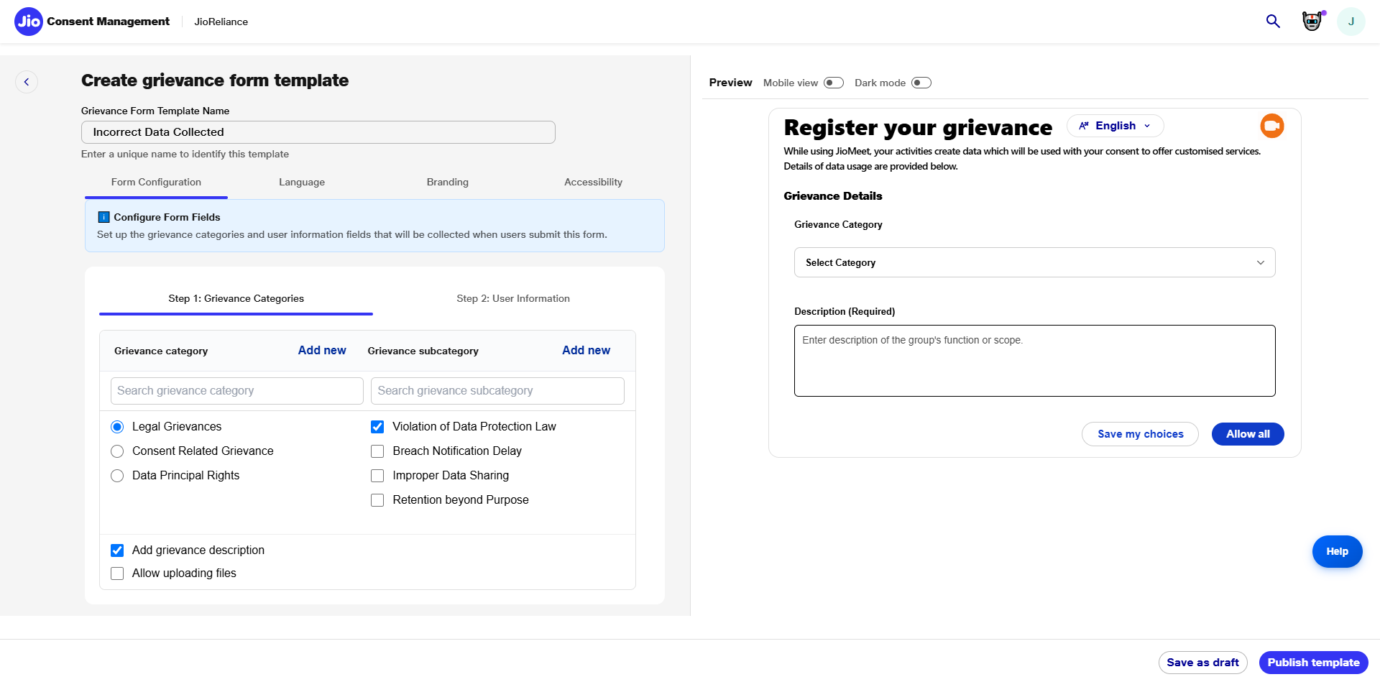
Notes:
Voiceover (~14 sec) “In Step One, the business user defines grievance categories and subcategories, enabling proper classification of user issues. Options such as legal grievances, data misuse, improper data sharing, and DPDP violations can be configured.”
On-Screen Text: Title: Create Grievance Template Subtitle: Step 1 — Configure Categories Key Text: Category Setup • Subcategories • Custom Fields CTA: Proceed to User Information Highlight Elements: Category list, subcategory checkboxes, description toggles.

Slide 21
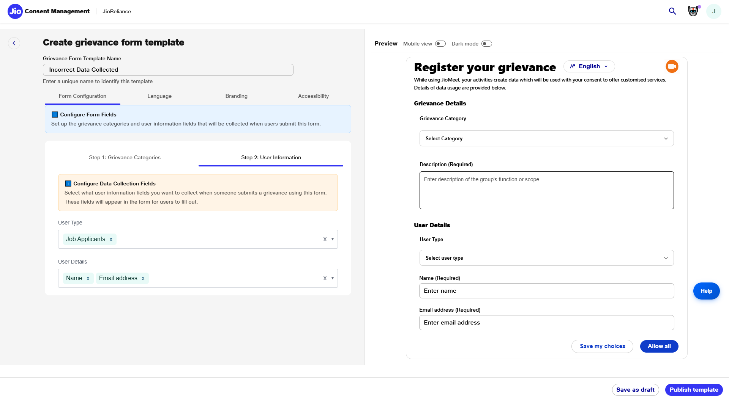
Notes:
Voiceover (~12 sec) “In Step Two, the data fiduciary sets the user information fields that will appear when a data principal submits a grievance—such as name, email ID, mobile number, and any additional required fields.”
On-Screen Text: Title: Create Grievance Template Subtitle: Step 2 — User Information Fields Key Text: User Type • Required Fields • Custom Inputs CTA: Continue to Language Settings Highlight Elements: User type dropdown, user detail fields.

Slide 22
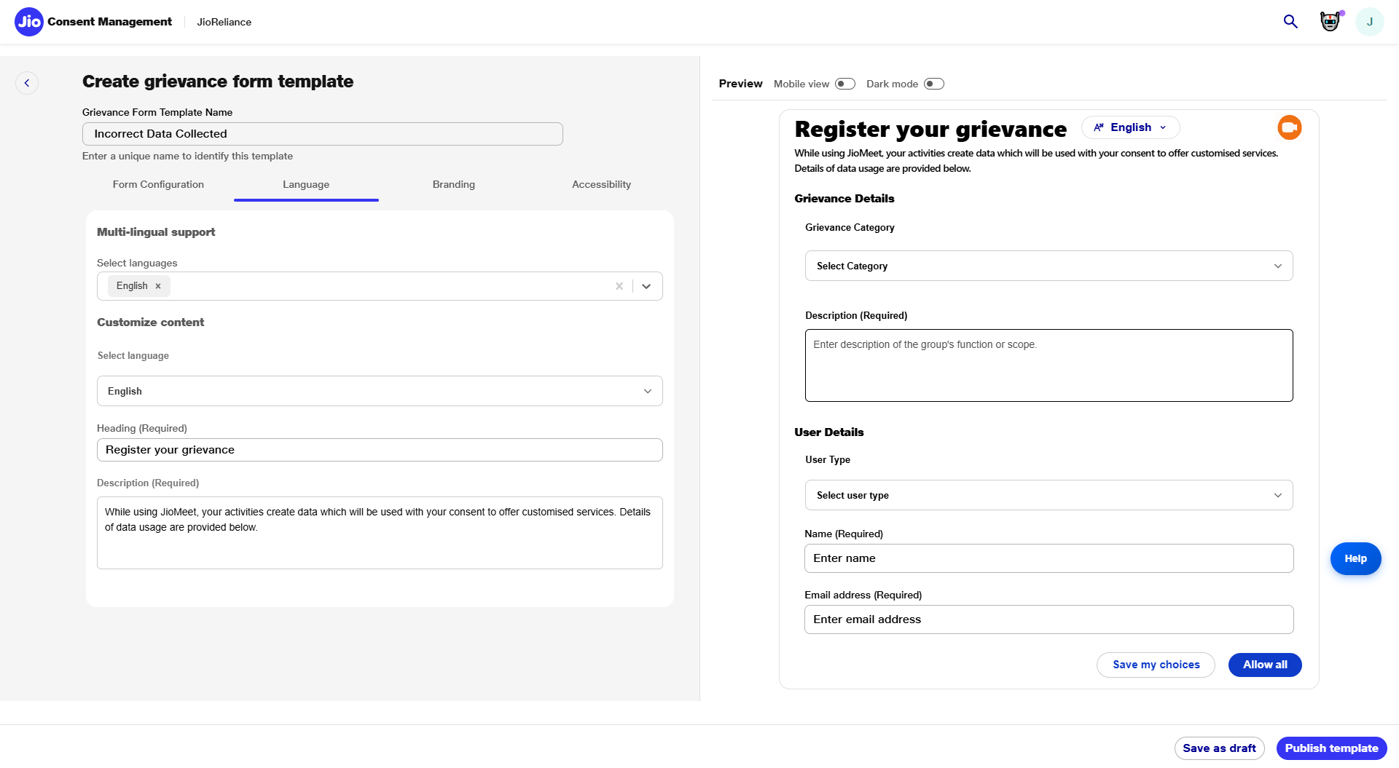
Notes:
Voiceover (~10 sec) “The Language tab enables multilingual support, allowing headings and descriptions to be customized for users in their preferred language, ensuring accessibility and inclusiveness.”
On-Screen Text: Title: Create Grievance Template Subtitle: Multi-Lingual Support Key Text: Localized Fields • Custom Headings CTA: Open Branding Options Highlight Elements: Language dropdown, heading field.

Slide 23
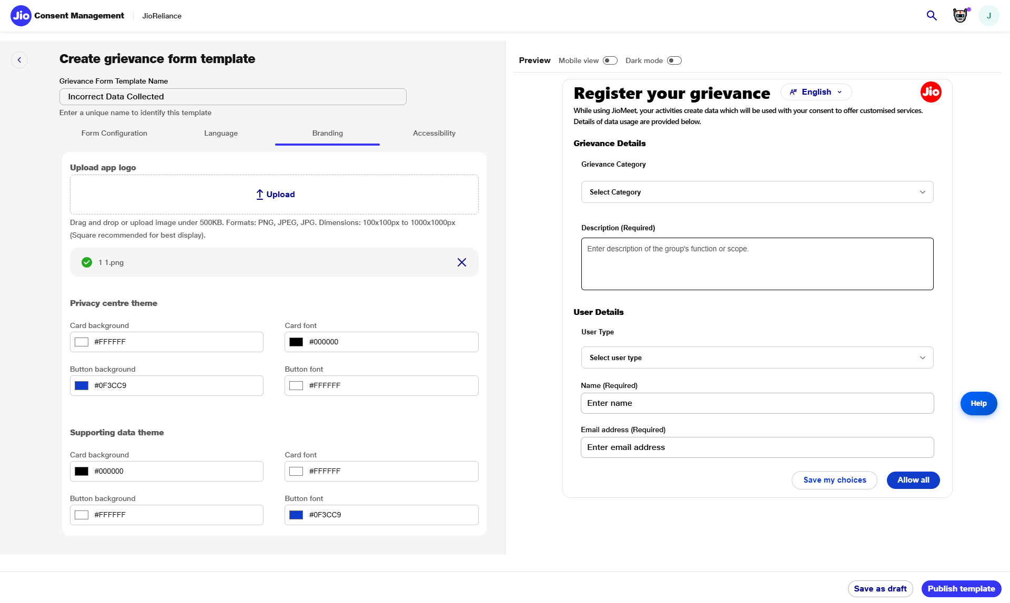
Notes:
Voiceover (~12 sec) “Branding options allow the business user to customize themes, colors, and logos. This ensures a consistent experience across the organization’s grievance forms.”
On-Screen Text: Title: Create Grievance Template Subtitle: Branding & Theme Customization Key Text: Logo Upload • Theme Settings • UI Consistency CTA: Configure Accessibility Highlight Elements: Logo upload, color pickers, preview panel.

Slide 24
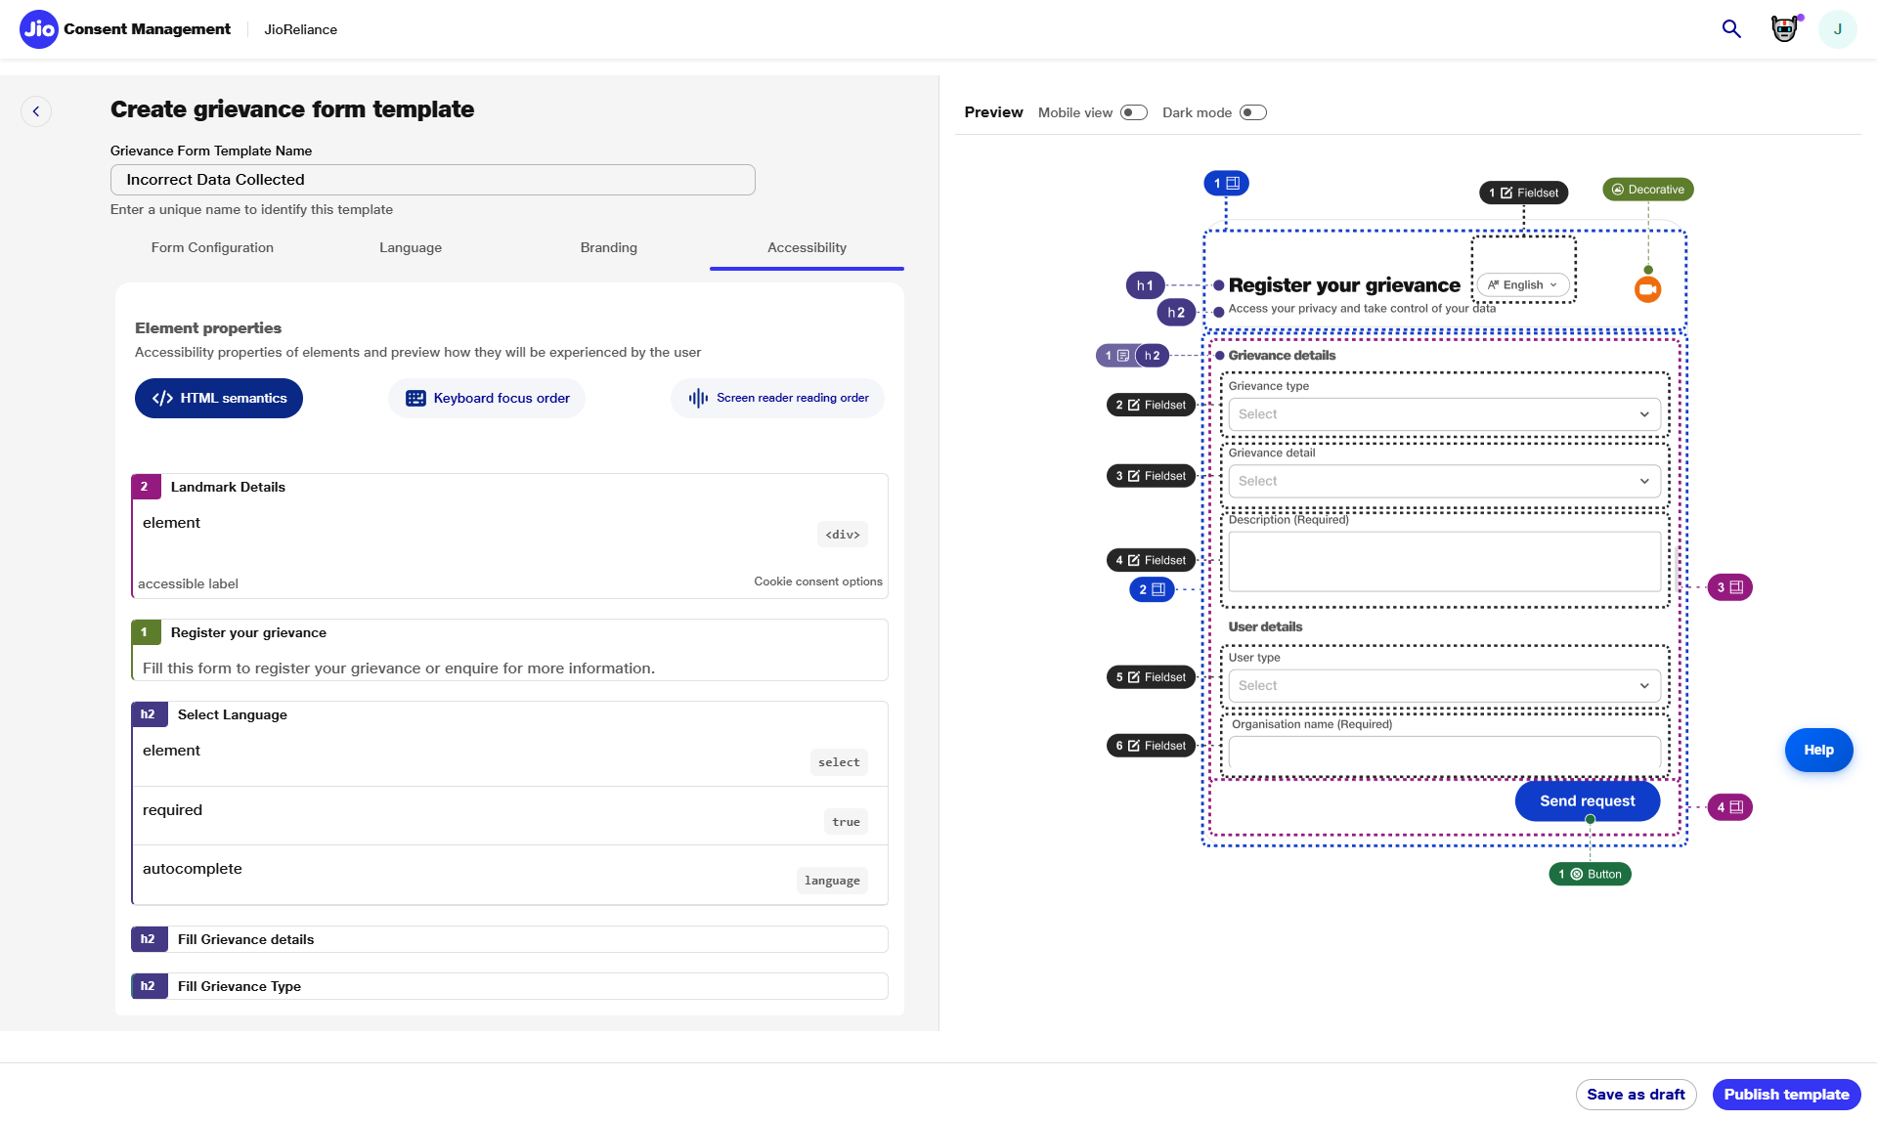
Notes:
Voiceover (~10 sec) “The Accessibility settings define keyboard navigation and focus order to ensure the form can be used by all, including users with assistive needs.”
On-Screen Text: Title: Accessibility Settings Subtitle: Keyboard Focus Order Key Text: Seamless Navigation • Inclusive UI CTA: Configure Screen Reader Experience Highlight Elements: Focus order indicators in preview.

Slide 25
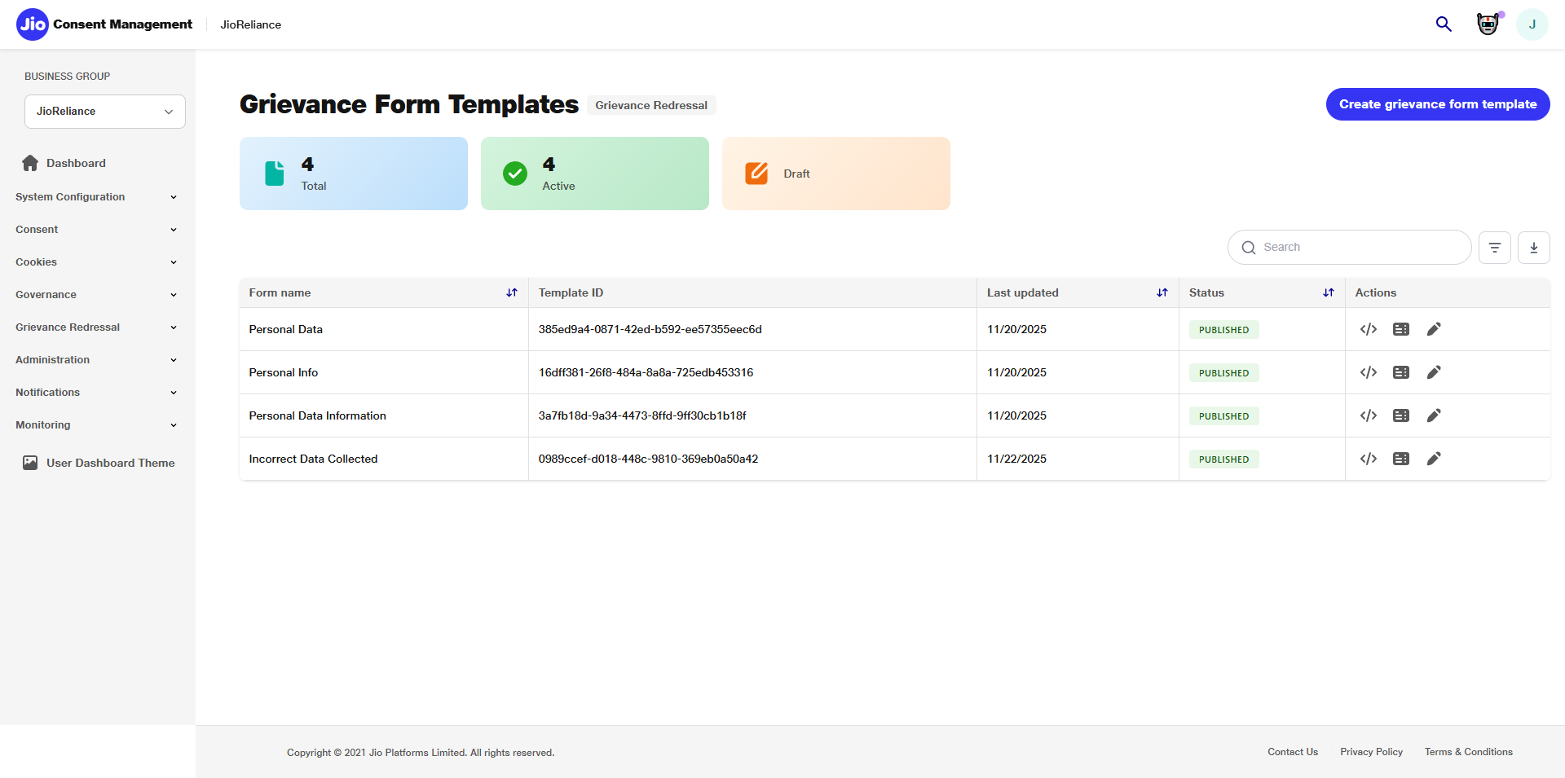
Notes:
Voiceover (~9 sec) “The newly created grievance form now appears in the list of templates, ready to accept submissions from data principals.”
On-Screen Text: Title: Template Published Subtitle: Form Now Available for Users Key Text: Updated Form Library CTA: Go to User Grievance Requests Highlight Elements: Newly added template row.

Slide 26
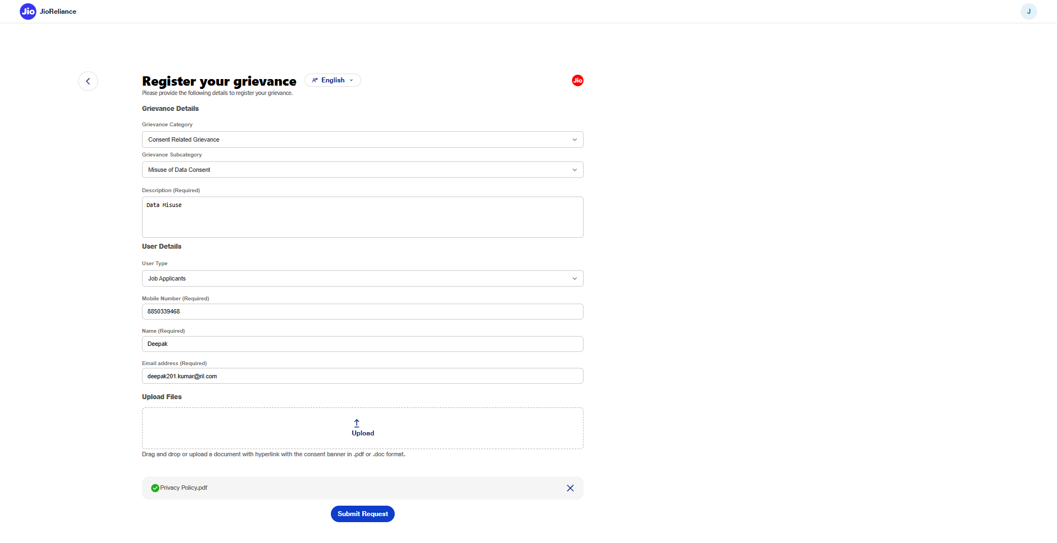
Notes:
Voiceover (~13 sec) “The user fills in the grievance form—including category, details, user information, and optional attachments—and submits the request.”
On-Screen Text: Title: Submit Grievance Subtitle: Enter Details & Attach Files Key Text: DPDP-Aligned Grievance Recording CTA: View Submitted Request Highlight Elements: Form fields, submit button.

Slide 27
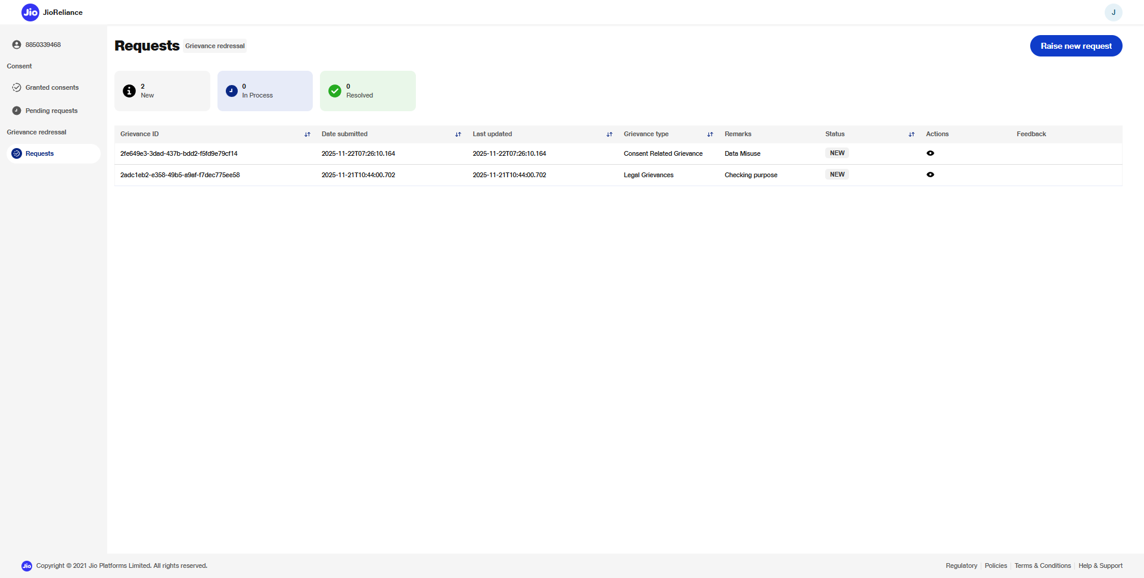
Notes:
Voiceover (~10 sec) “After submission, the grievance instantly appears in the user’s Requests list with a status marked as NEW.”
On-Screen Text: Title: Grievance Submitted Subtitle: Status: NEW Key Text: Real-Time Status Updates CTA: Switch to Fiduciary View Highlight Elements: NEW status badge.

Slide 28
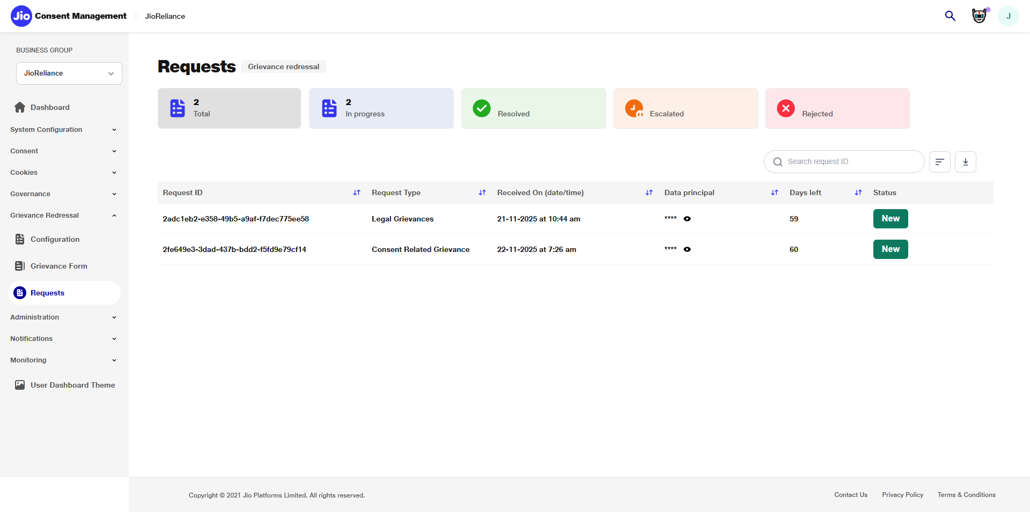
Notes:
Voiceover (~10 sec) “In the fiduciary portal, the business user views all submitted grievances along with category, timestamps, and pending SLA timelines.”
On-Screen Text: Title: Grievance Requests Subtitle: Dashboard for Fiduciary Review Key Text: Categorized • Timestamped • SLA-Tracked CTA: Open Submitted Grievance Highlight Elements: Requests list.

Slide 29
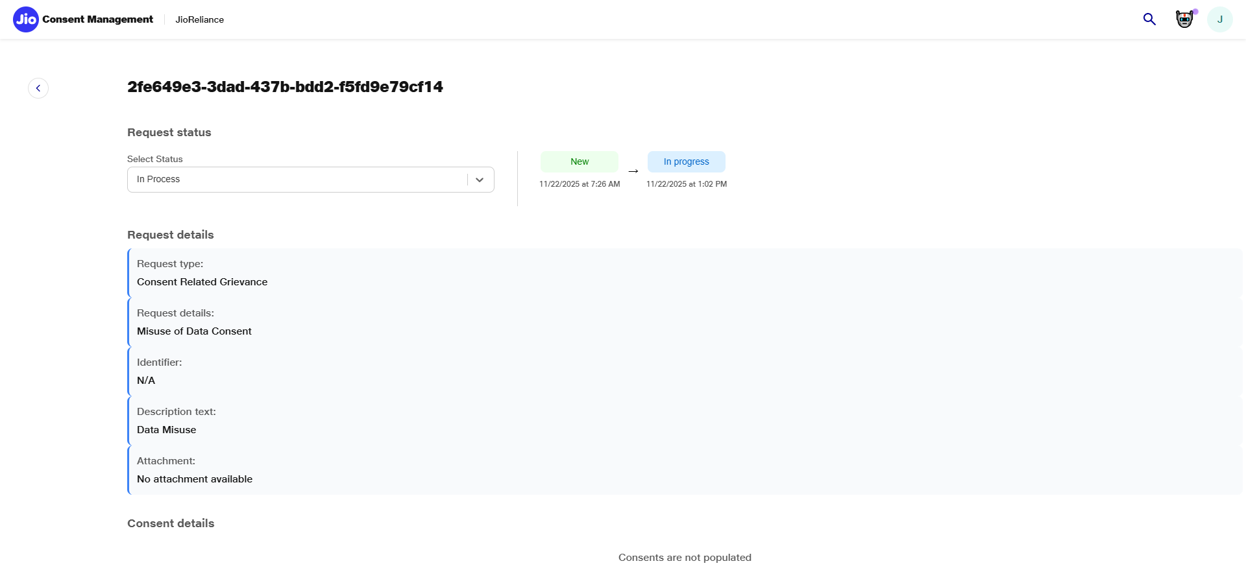
Notes:
Voiceover (~10 sec) “After review, the fiduciary updates the grievance status to In Progress, indicating that investigation has begun.”
On-Screen Text: Title: Update Status Subtitle: Mark as In Progress Key Text: Status Updated Successfully CTA: View User Dashboard Update Highlight Elements: Status dropdown.

Slide 30
Notification & Communication Services
Email & SMS Notifications
CMS integrates with SMTP and SMSC gateways to deliver consent, cookie, grievance, and renewal notifications. Includes templates and multi-language support.
DF & Processor Callbacks
Events like consent grant, update, withdrawal, renewal, and grievance submissions are pushed to DF/processor systems via secure webhook callbacks.
Dead-letter Queue & Retry
Failed notifications are queued for retries with exponential backoff. Ensures reliability and delivery guarantees at scale.

Slide 31
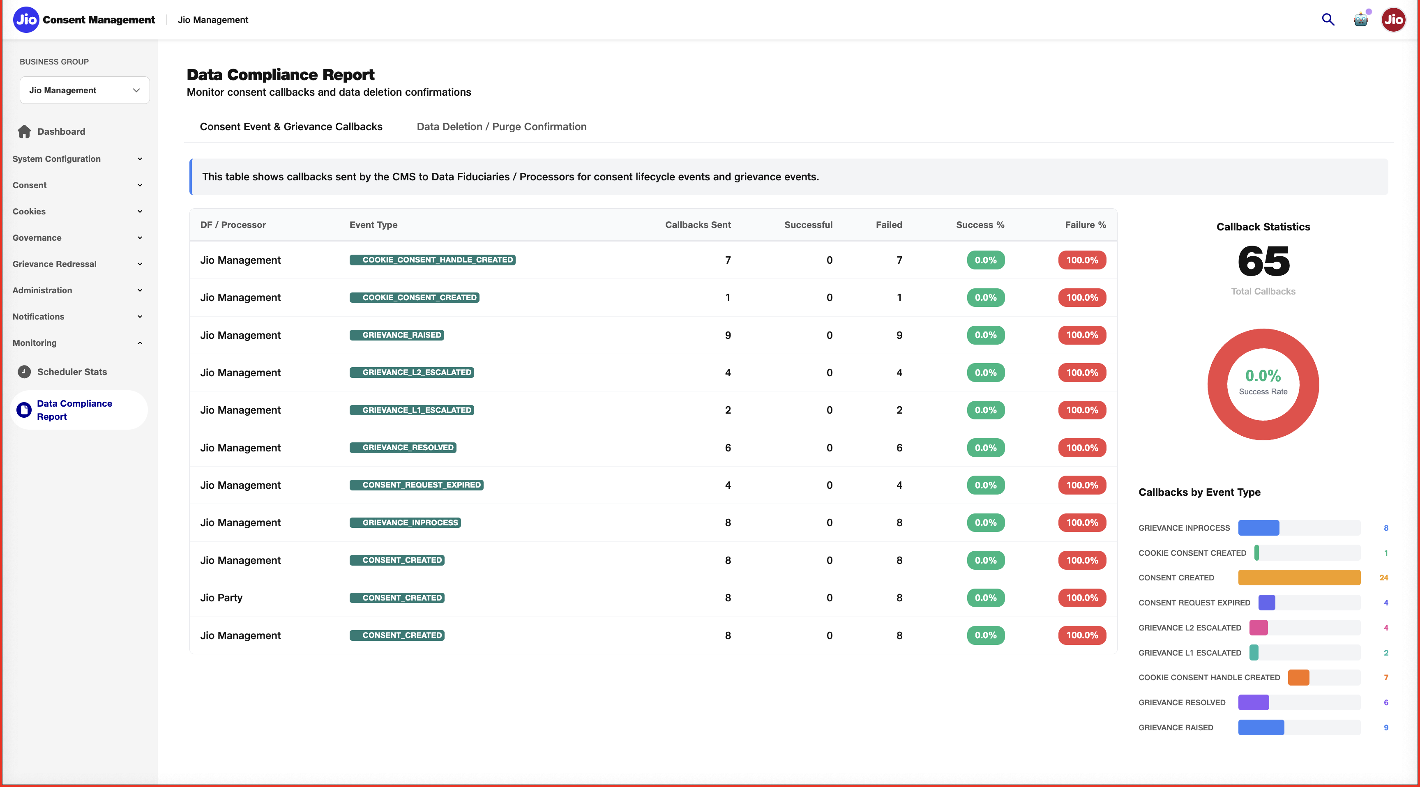

Slide 32
Audit & Compliance
Immutable Audit Logging
Every CMS activity (user, system, API) is recorded in an append-only, hash-linked structure to ensure audit integrity and tamper-proof evidence.
Compliance Dashboard
Legal entities get real-time visibility into logs, SLA breaches, privacy violations, and system health to meet DPDP and internal governance needs.
Cryptographic Chain Verification
Supports recomputation of SHA-256 hash chain to validate whether any consent or grievance record has been tampered with.

Slide 33
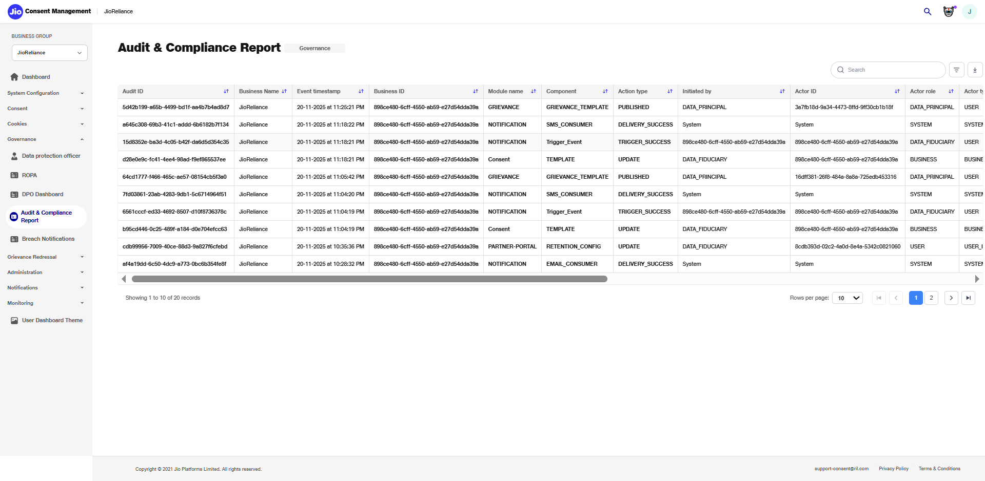

Slide 34
CMS Portal & Admin Console
Tenant & Legal Entity Onboarding
Each DF is provisioned as an isolated tenant with dedicated database and configuration setup. PAN-based uniqueness ensures regulatory compliance.
Configuration Management
CMS provides system setup for SMTP, SMSC, callbacks, templates, DPO information, retention policies, multilingual preferences, and signing settings.
Business Application & Role Setup
Legal Entity Admin can create business groups, define roles, assign permissions, and onboard users to control access to CMS modules.
Dashboard
Shows consolidated operational metrics including consents collected, grievances open, callbacks delivered, notification usage, and audit summaries.

Slide 35
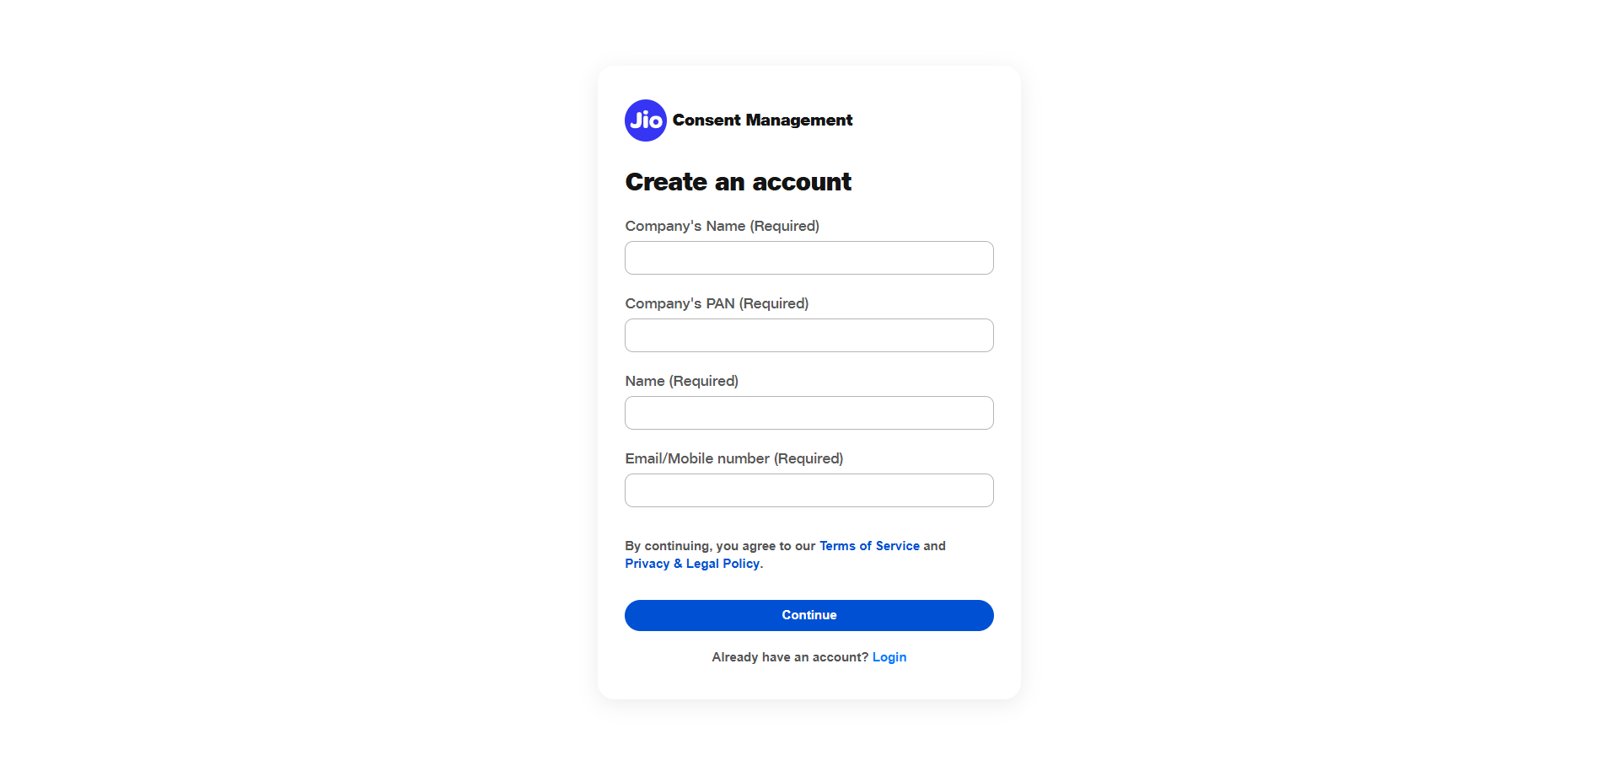
Notes:
Voiceover (8–10 sec):
"The business user starts by creating an account, entering their company details, PAN, and contact information. This begins the secure onboarding process for accessing the Consent Management System."
On-Screen Text:
Title: Create an Account Subtitle: Register your organization to access Consent Management. Key On-Screen Text: Required details ensure authenticity and compliance. CTA: Click Continue
Highlight Elements:
Company Name
PAN
Email/Mobile
Continue button

Slide 36
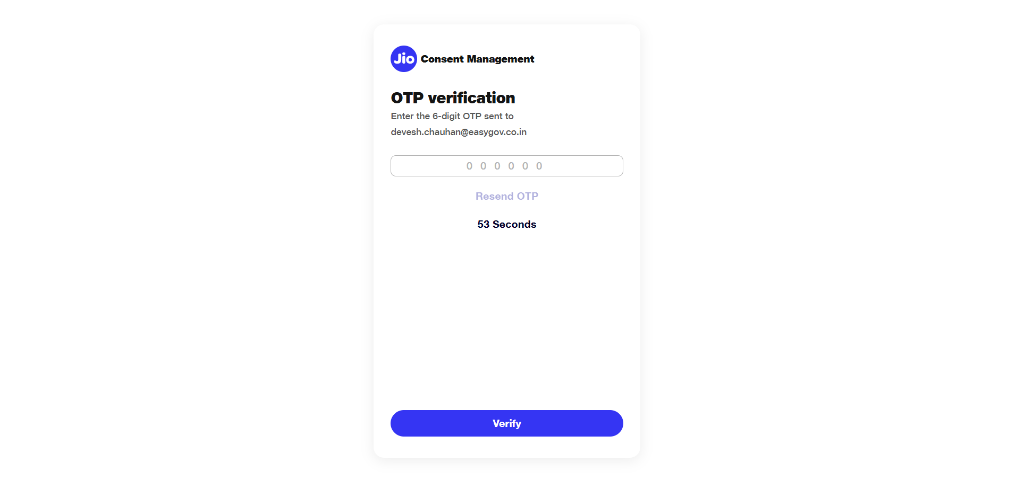
Notes:
Voiceover (9–11 sec):
"A verification OTP is sent to the business user's registered contact. They enter the six-digit code to confirm their identity. If the OTP expires or is not received, the user can request a new one using Resend OTP."
On-Screen Text:
Title: OTP Verification Subtitle: Verify your identity to complete account creation. Key On-Screen Text: Use Resend OTP if the code expires or isn’t delivered. CTA: Click Verify
Highlight Elements:
OTP input
Resend OTP
Verify button

Slide 37
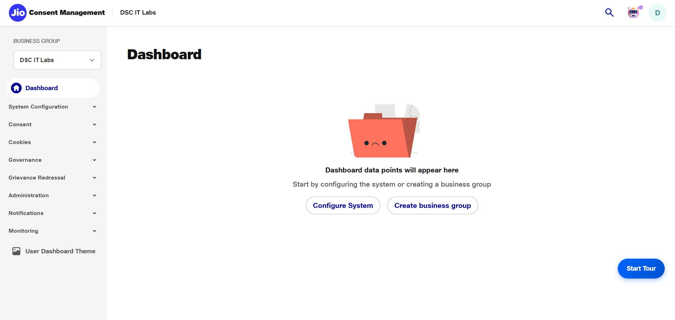
Notes:
Voiceover (8–10 sec):
"Once OTP verification is successful, the business user is redirected to the home dashboard, where system configuration and business group setup can begin."
On-Screen Text:
Title: Signup Successful Subtitle: Welcome to the Consent Management Dashboard. Key On-Screen Text: Configure your setup or create a business group to get started. CTA: Click Configure System or Create Business Group
Highlight Elements:
Configure System button
Create Business Group button
Start Tour button (optional highlight)

Slide 38
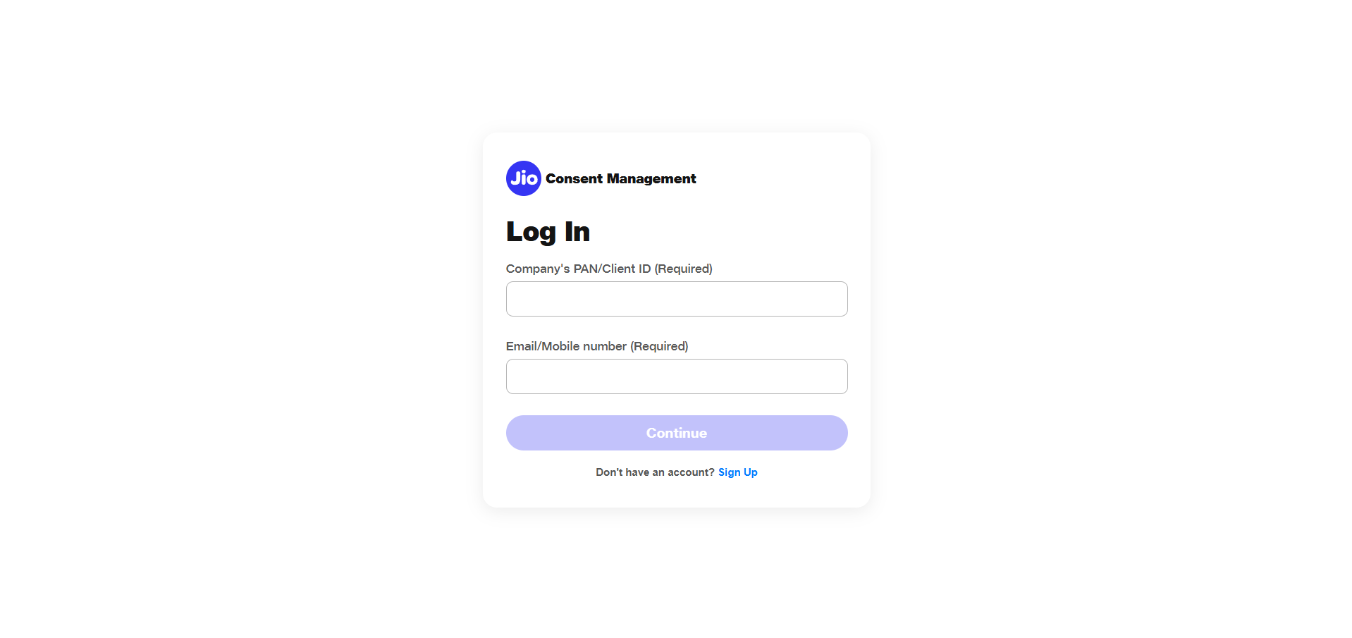
Notes:
Voiceover (8–9 sec):
"For returning business users, logging in is simple. They enter their company PAN or Client ID and their registered email or mobile number to begin authentication."
On-Screen Text:
Title: Log In Subtitle: Secure access for returning business users. Key On-Screen Text: Identity validation starts with PAN or Client ID. CTA: Click Continue
Highlight Elements:
PAN / Client ID field
Email/Mobile field
Continue button

Slide 39
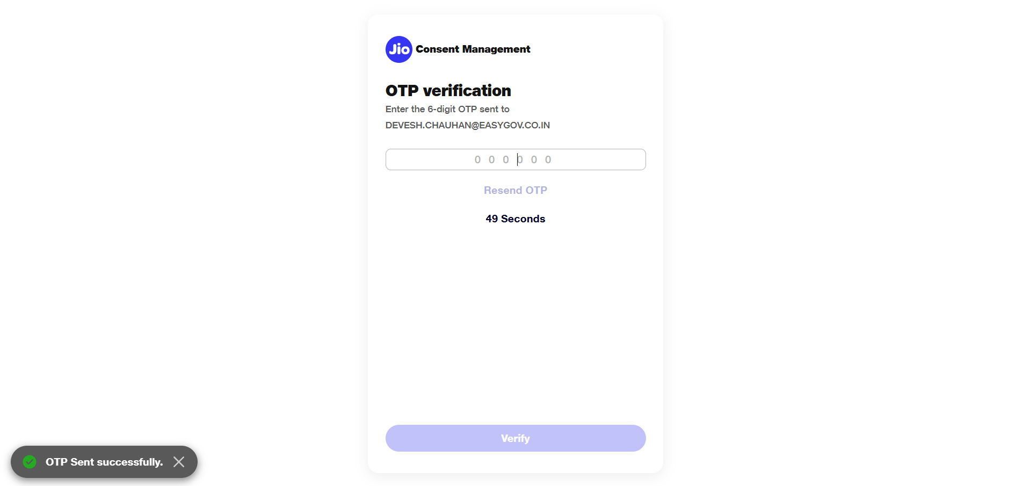
Notes:
Voiceover (8–10 sec):
"A six-digit OTP is sent to the business user's registered contact to authenticate their login. This password-less approach ensures both simplicity and security."
On-Screen Text:
Title: OTP Verification Subtitle: Enter the OTP to authenticate your login. Key On-Screen Text: Secure password-less authentication. CTA: Click Verify
Highlight Elements:
OTP field
Resend OTP
Verify button
Success toast (optional)

Slide 40
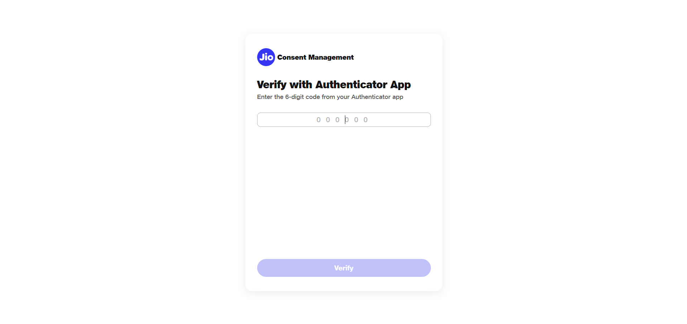
Notes:
Voiceover (10–12 sec):
"The system may require multi-factor authentication for enhanced protection. The user enters the six-digit code generated by their authenticator app to complete verification."
On-Screen Text:
Title: Multi-Factor Authentication Subtitle: Enter the authenticator code to secure your session. Key On-Screen Text: MFA adds an additional compliance-focused security layer. CTA: Click Verify
Highlight Elements:
Authenticator code field
Verify button

Slide 41
Notes:
Voiceover (7–9 sec):
"After completing verification, the business user lands on the dashboard, ready to begin configuration, consent setup, or system operations."
On-Screen Text:
Title: Login Successful Subtitle: You're now securely logged in. Key On-Screen Text: Real-time access to all system modules. CTA: Click Start Tour or select a module
Highlight Elements:
Left navigation
Configure System
Create Business Group
Profile icon

Slide 42
Identity, Access & RBAC
1. DF User Authentication
DF users log in via PAN + email/phone OTP. Ensures secure but simple access to CMS portal.
2. Role-Based Access Control
Supports configurable roles like Legal Entity Admin, Business Admin, Operator, and Auditor with object-level access control.
3. Session & Token Management
OAuth2-based token issuance, session timeout enforcement, correlation ID tracking, and signing of responses for integrity.

Slide 43
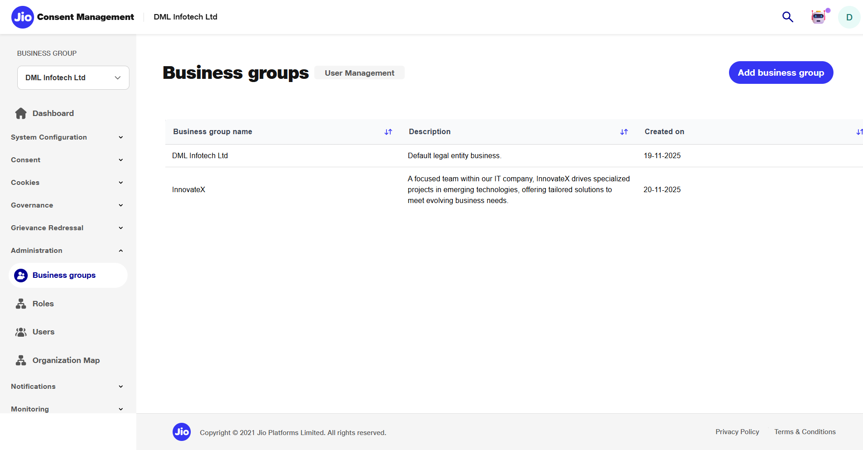
Notes:
Voiceover (9–11 sec):
"The newly added business group now appears in the list, ready to be associated with roles and users."
On-Screen Text:
Title: Group Added Subtitle: Business unit successfully created Key Text: Visible in organisation structure CTA: Continue to Roles Highlight: Newly added row

Slide 44
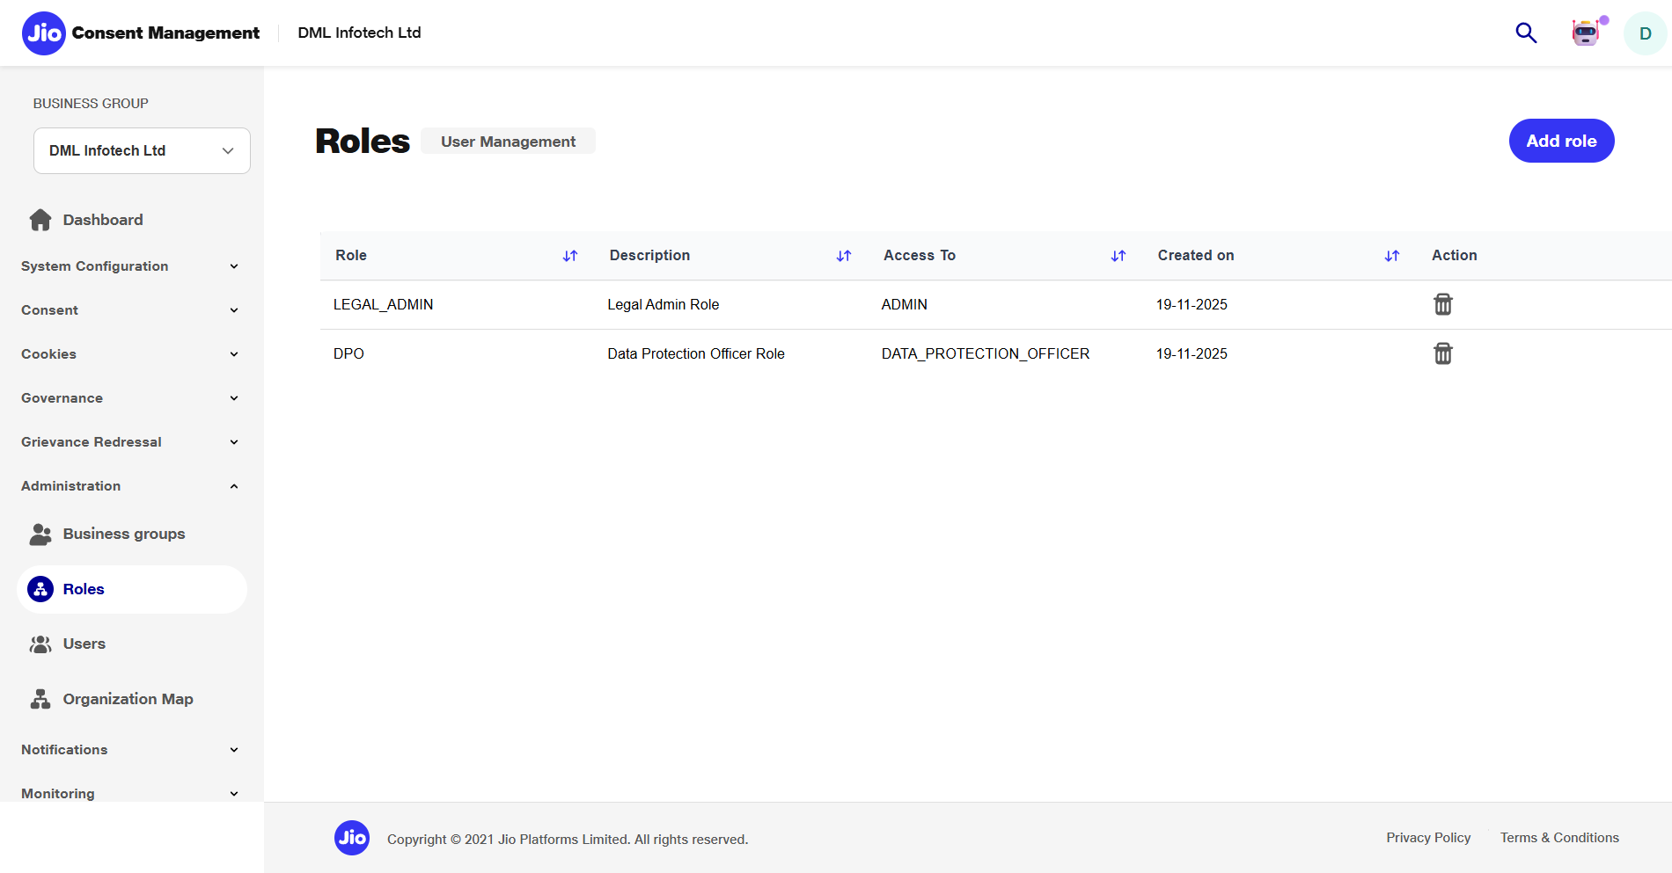
Notes:
Voiceover (10–12 sec):
"In the Roles section, Data Fiduciaries define access bundles. Each role specifies which modules, features, and administrative actions users are authorised to perform."
On-Screen Text:
Title: Roles Subtitle: Define permission sets Key Text: Control system access at granular levels CTA: Click Add Role Highlight: Add Role button

Slide 45
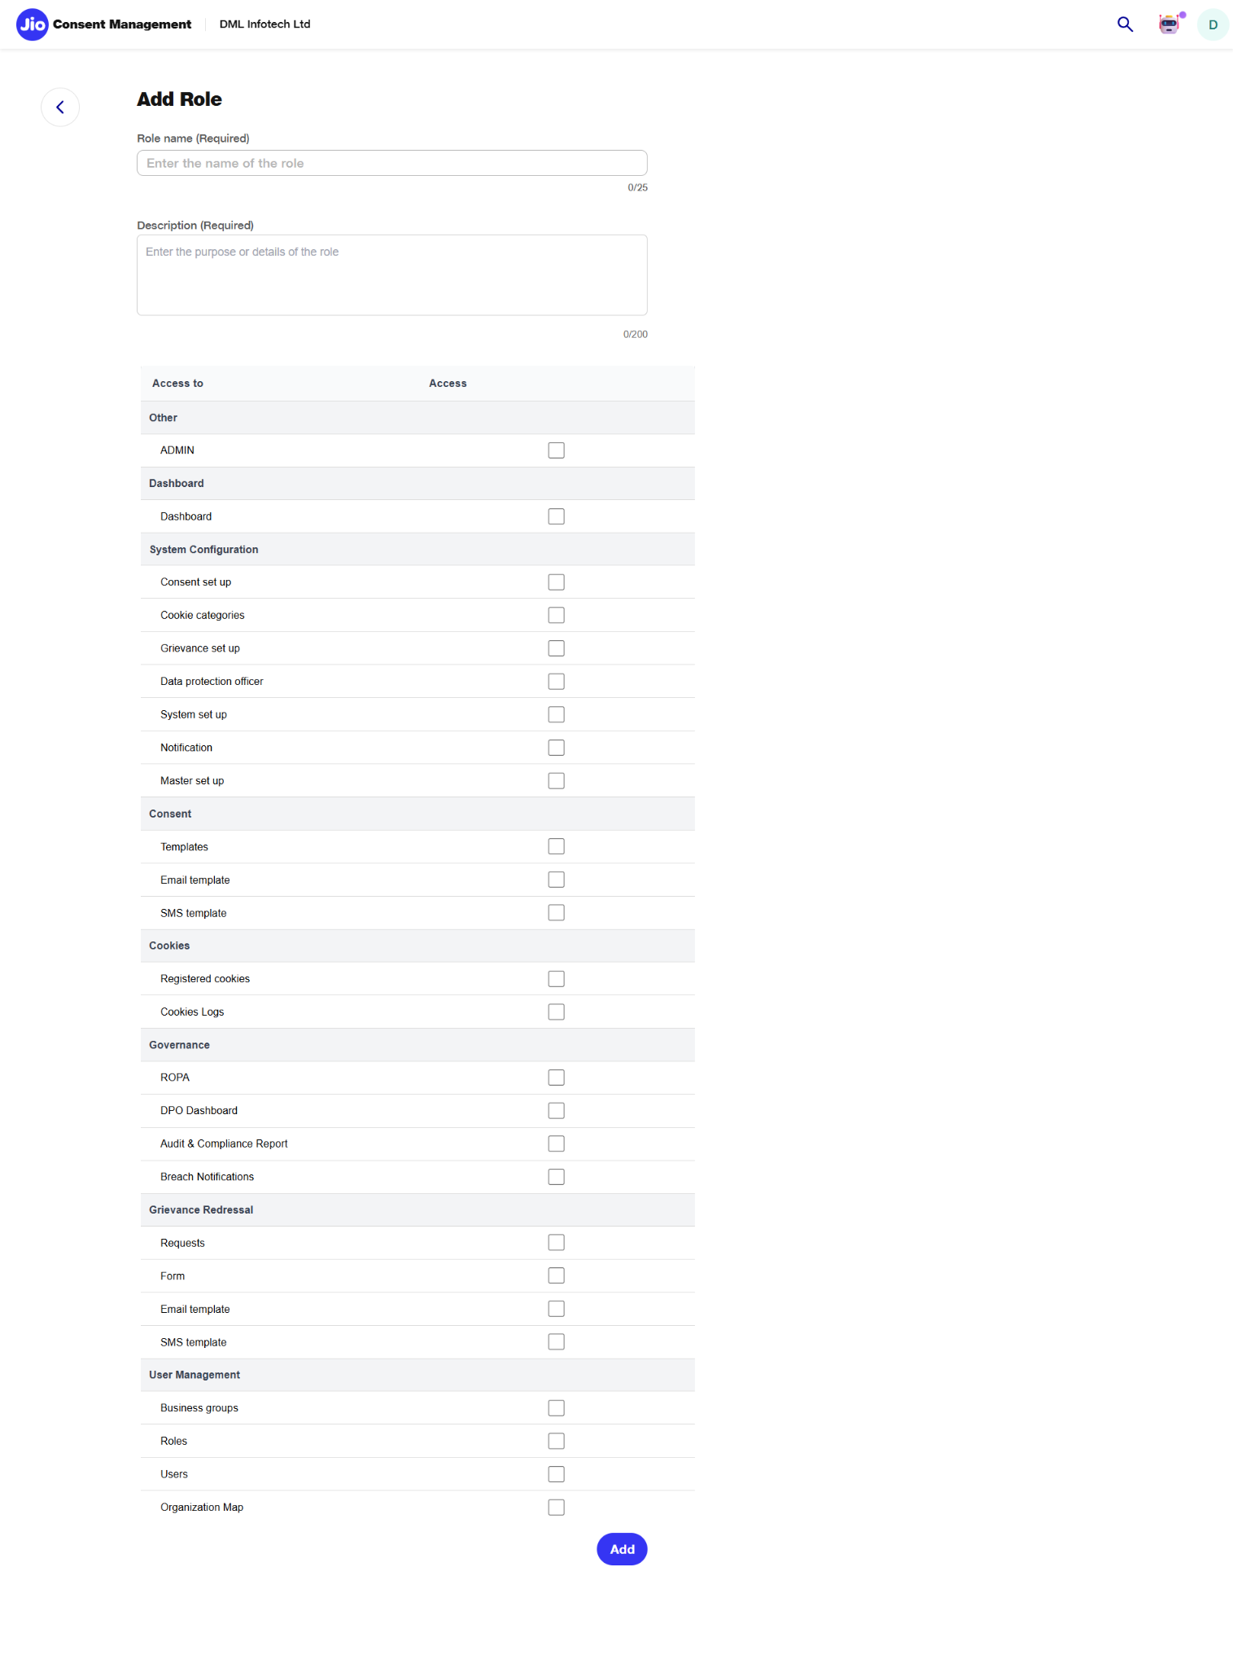
Notes:
Voiceover (12–14 sec):
"To create a new role, enter the role name, add a description, and select the modules and actions that should be accessible. RBAC ensures each user only sees the functions relevant to their responsibility."
On-Screen Text:
Title: Create Role Subtitle: Configure module-level permissions Key Text: Assign only required access CTA: Select Permissions Highlight: Role name, description, permission categories

Slide 46
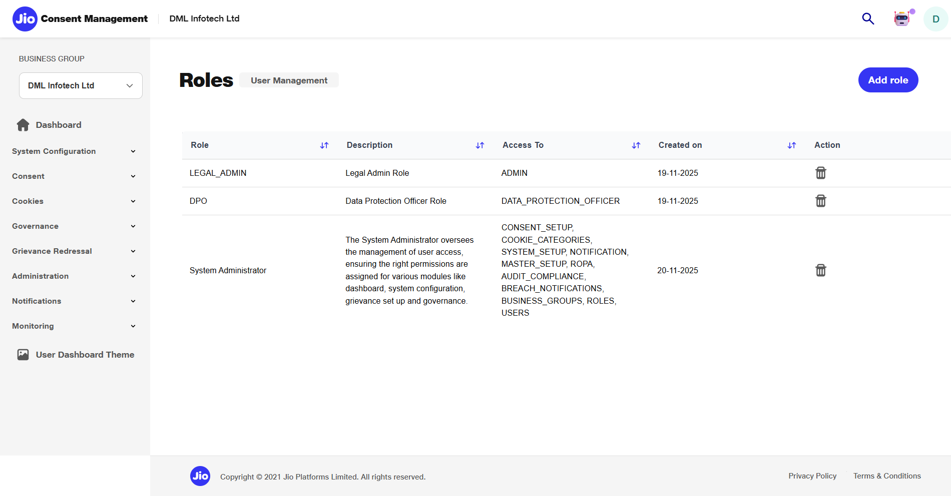
Notes:
Voiceover (9–10 sec):
"The newly created role is now visible in the list, complete with a summary of its permissions for easy reference and auditing."
On-Screen Text:
Title: Role Added Subtitle: RBAC role is now active Key Text: Permissions visible in summary CTA: Proceed to User Management Highlight: New role row

Slide 47
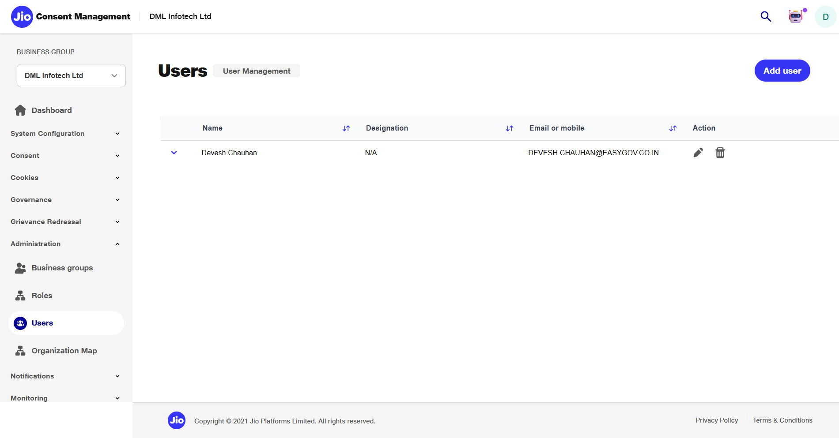
Notes:
Voiceover (10–12 sec):
"Under the Users section, the business user can view all system users and assign newly created roles based on the organisation’s operational structure."
On-Screen Text:
Title: User Management Subtitle: View user accounts and assigned roles Key On-Screen Text: Manage access for every user CTA: Click Add User
Highlight Elements:
Add User button

Slide 48
Integration Framework
Callback & Webhook Management
DFs can configure URLs to receive events for consent, grievance, and status changes. Webhooks include JWS signatures for authenticity.
SecureCode Generator API
Generates time-bound secure access tokens for embedded consent, cookie, and grievance journeys used inside DF’s platform or app.
JS Widget Integration
Provides DF websites with a JS bundle to embed consent/cookie UI without handling logic internally.
DigiLocker Integration
Used for parental KYC and identity verification where required under minors’ consent law.
Bhashini AI Integration
Provides fast, reliable translation for consent templates, cookie text, grievance forms, and notifications in 22+ languages.
Vault & WSO2 Wrappers
Platforms abstract Vault for key management and

Slide 49
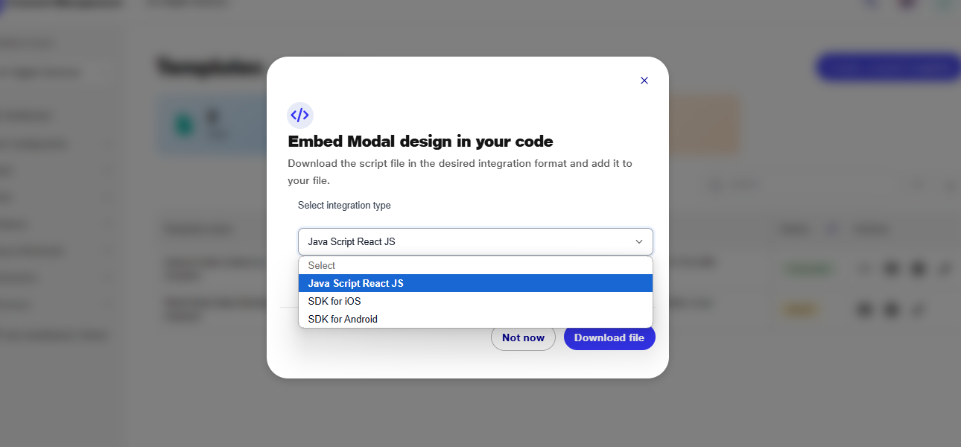

Slide 50
Cross-Cutting Platform Services
Scheduler / Workflow Engine
Monitors consent expiries, SLA deadlines, renewal reminders, escalation flows, and scheduled reports.
Translation & Localization Service
Ensures all UI modules support multilingual content and accessibility (WCAG 2.1 AA aligned).
HashiCorp Vault Wrapper
Securely stores RSA keys, encrypts payloads, signs artifacts, and manages versioning without exposing raw keys.
WSO2 Credential Wrapper
Generates client credentials for DF onboarding and securely rotates keys as per policy.

Slide 51
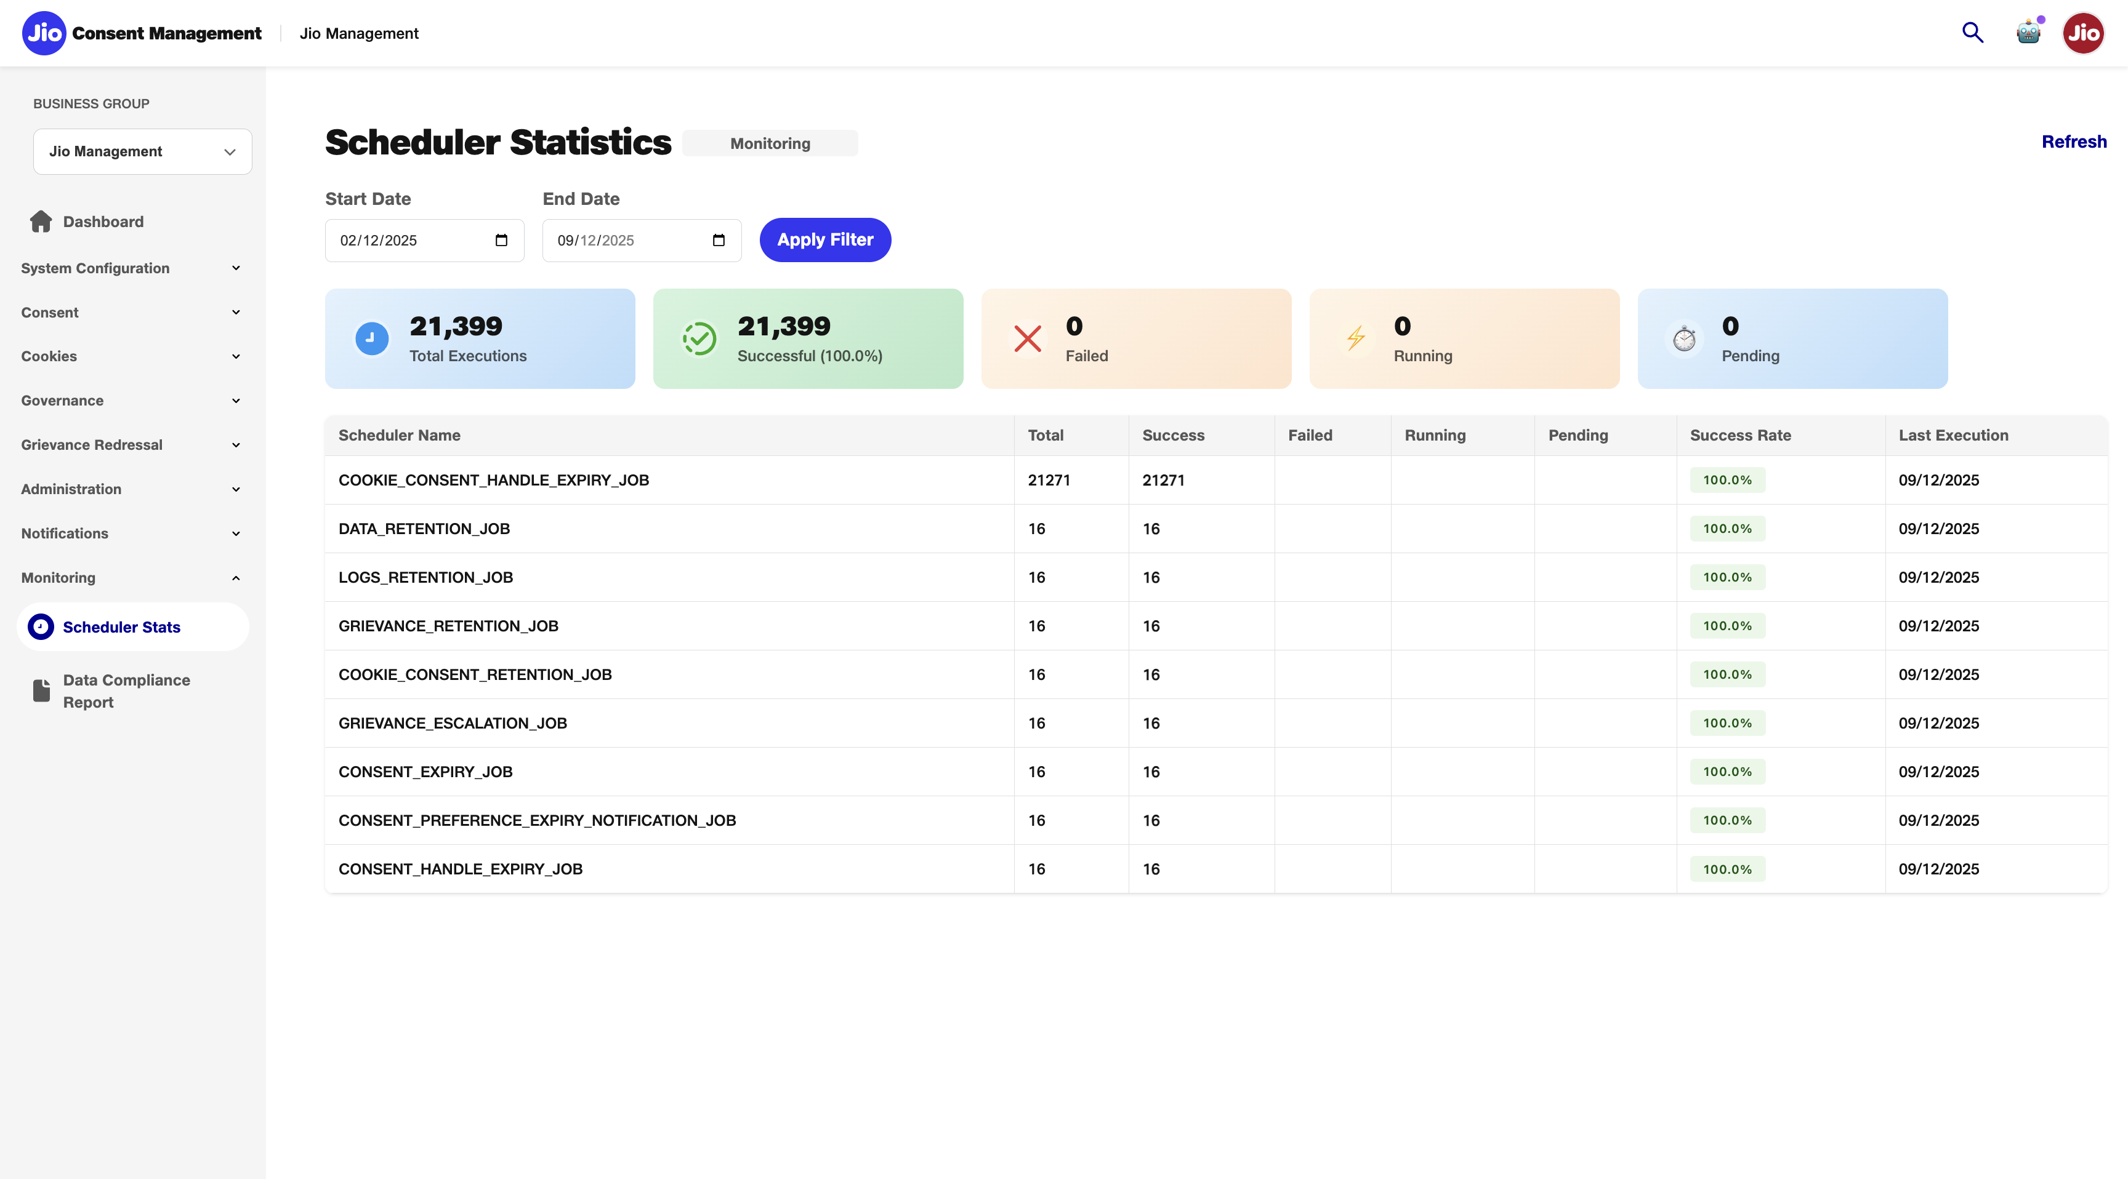

Slide 52
Thankyou.

